Slide 1
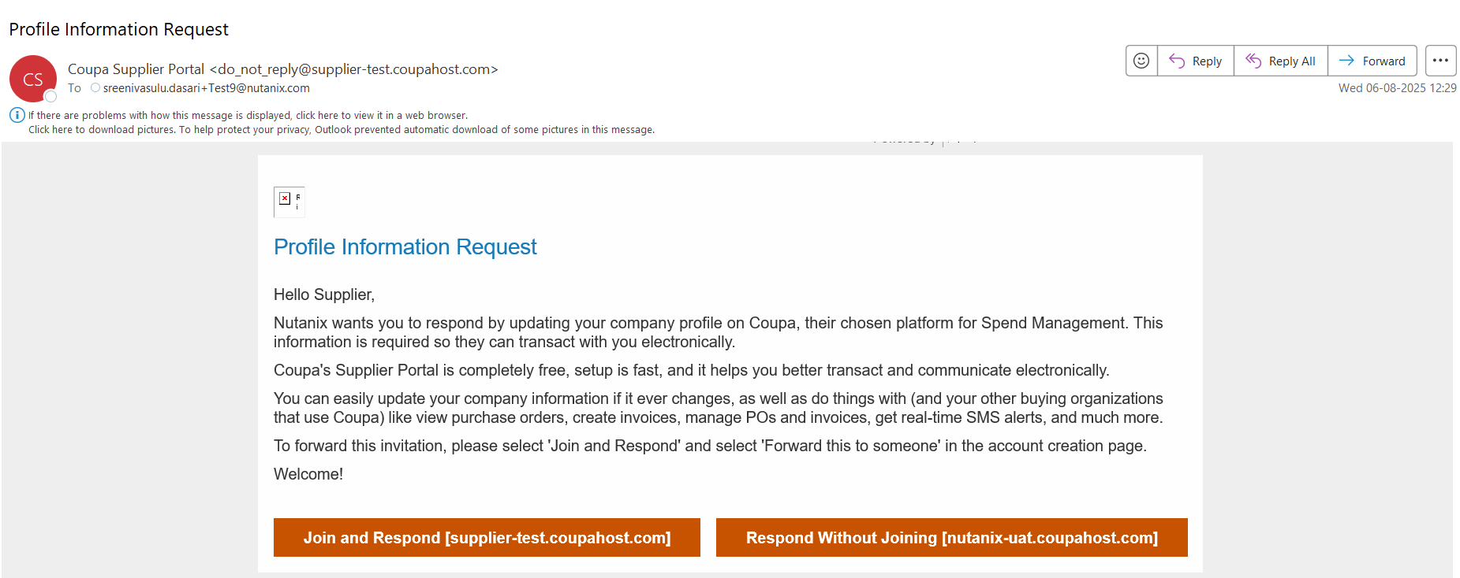
As a supplier, you may receive this email to the email ID listed / Provided under primary contact details
To register, you must click "Join and Respond," which will direct you to the Coupa Supplier Portal.

Slide 2
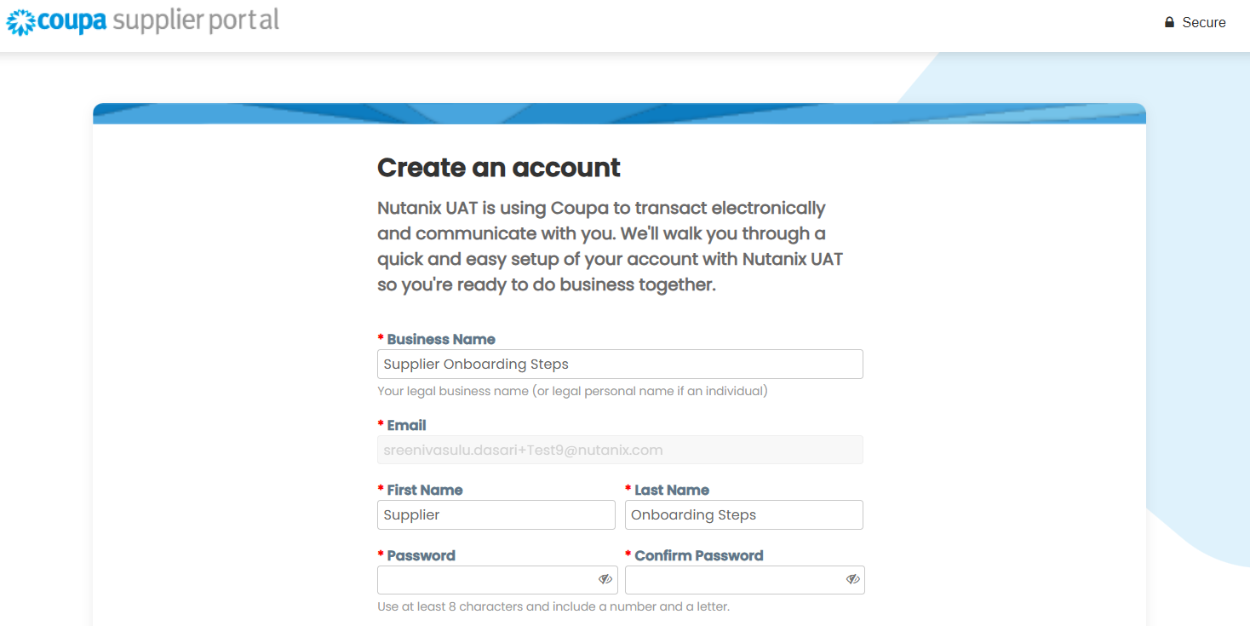
Please check your business name
Your Primary email ID
Fill your first name & Last name
Create your Password and confirm

Slide 3
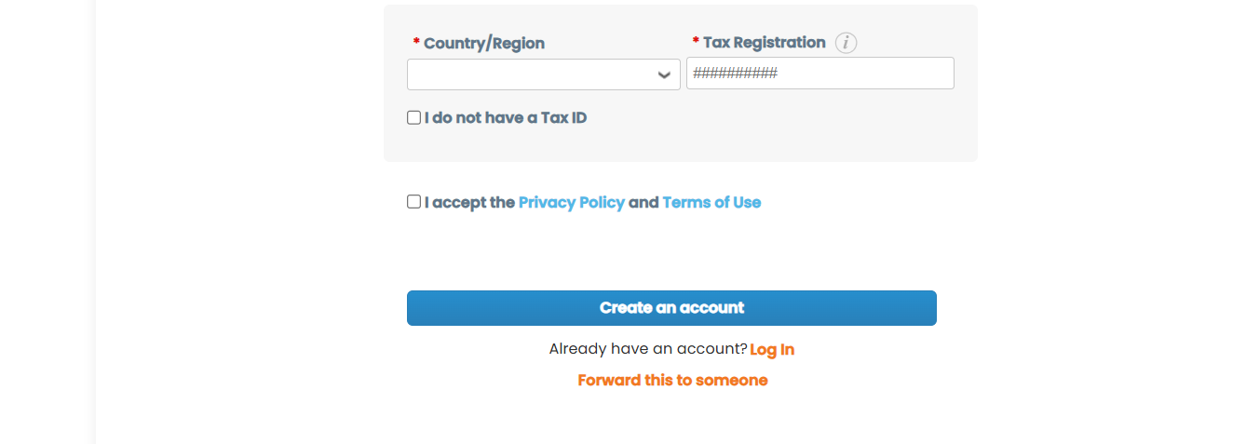
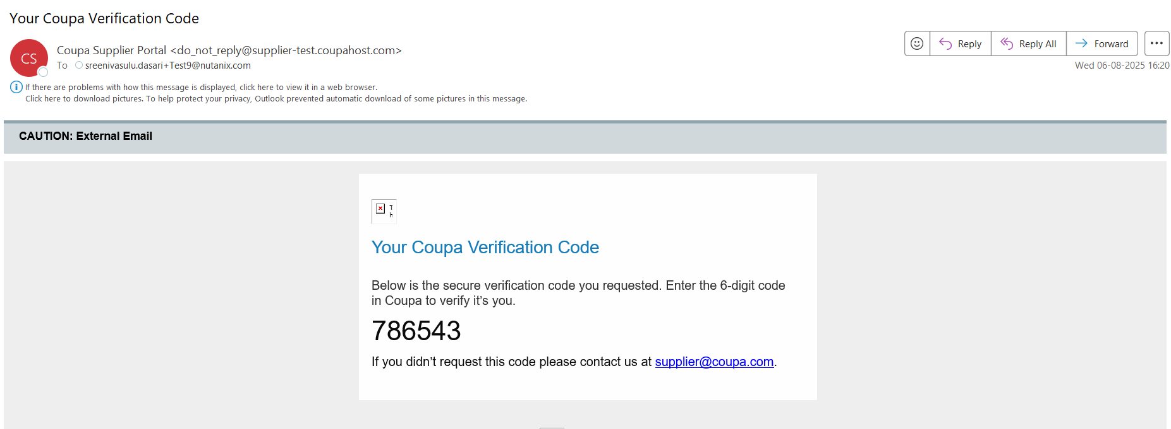
Select your Country
Provide your tax registration Number
Check this box
If you already have an account in Coupa with the same email ID provided to us, you may login using existing credentials
Click on Create an account
You may forward this to someone else who can fill all these details. but make sure to use the same email ID for login
A six-digit code will be sent to your registered email address once you click "Create an account." Please update the code and click "Next."
This is how you receive 6-digit verification code email

Slide 4
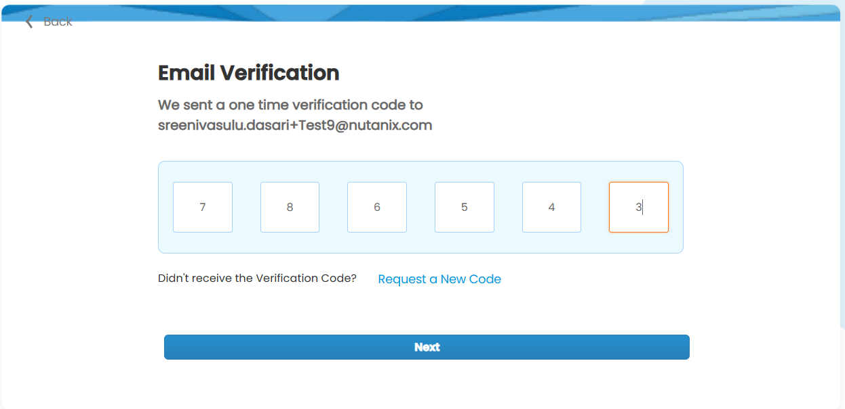
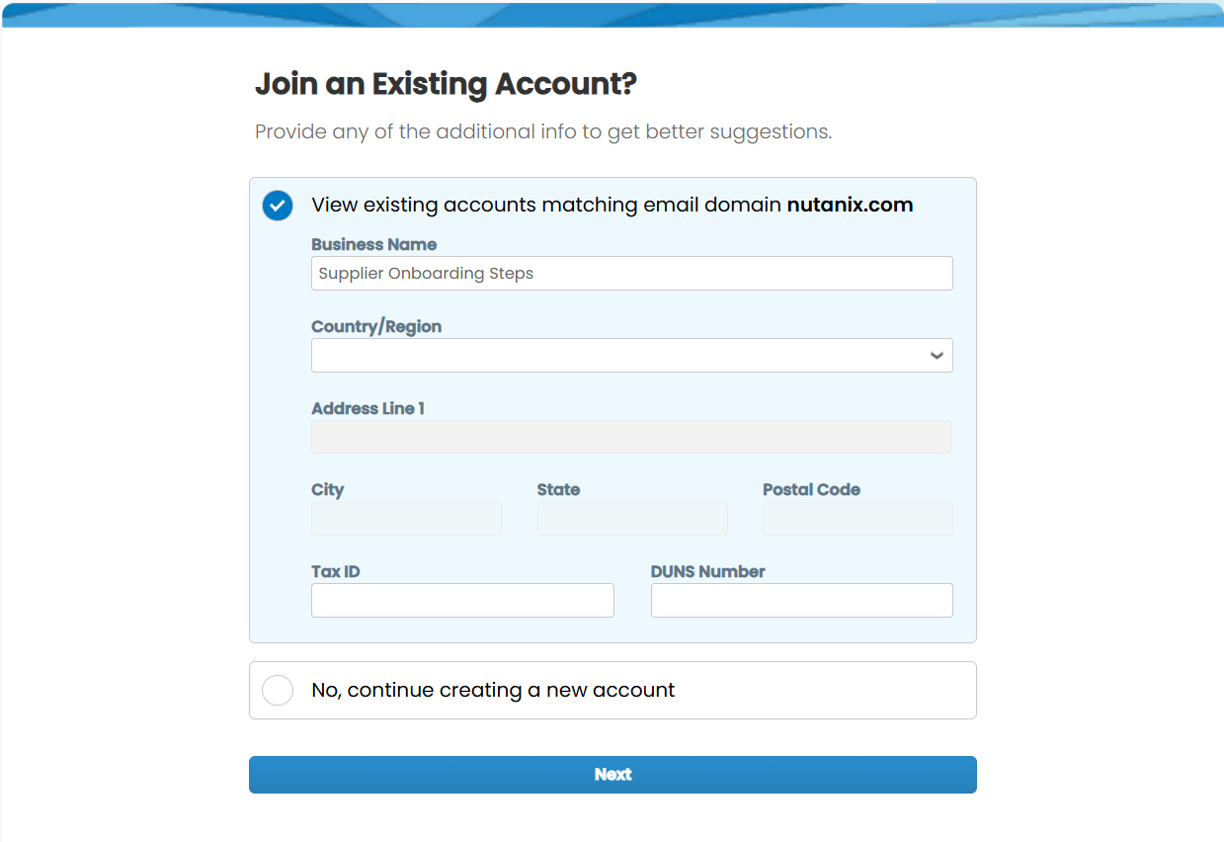
Enter the six-digit code sent your registered email ID
Click Next
If you already have an account in Coupa (with other customers) you can just login through your existing login details.
You may continue creating new account in case you do not have any account with Coupa
Click Next

Slide 5
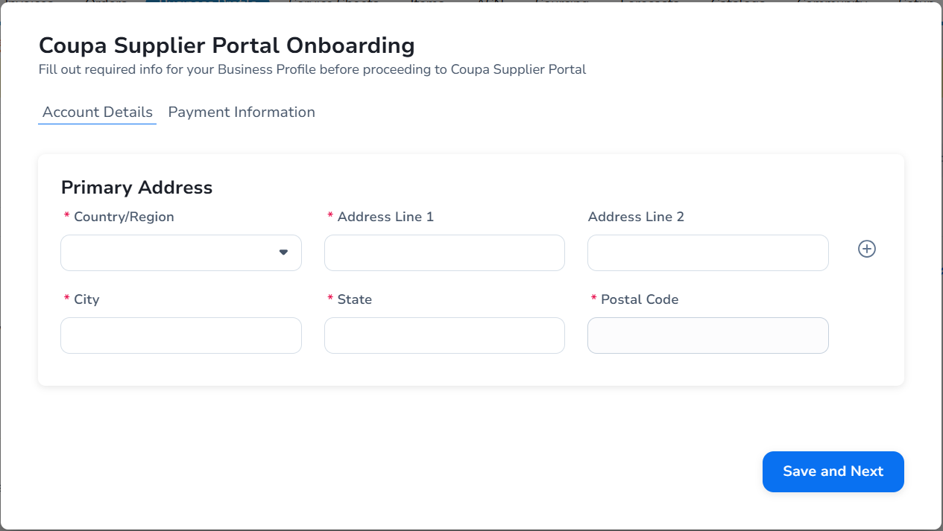
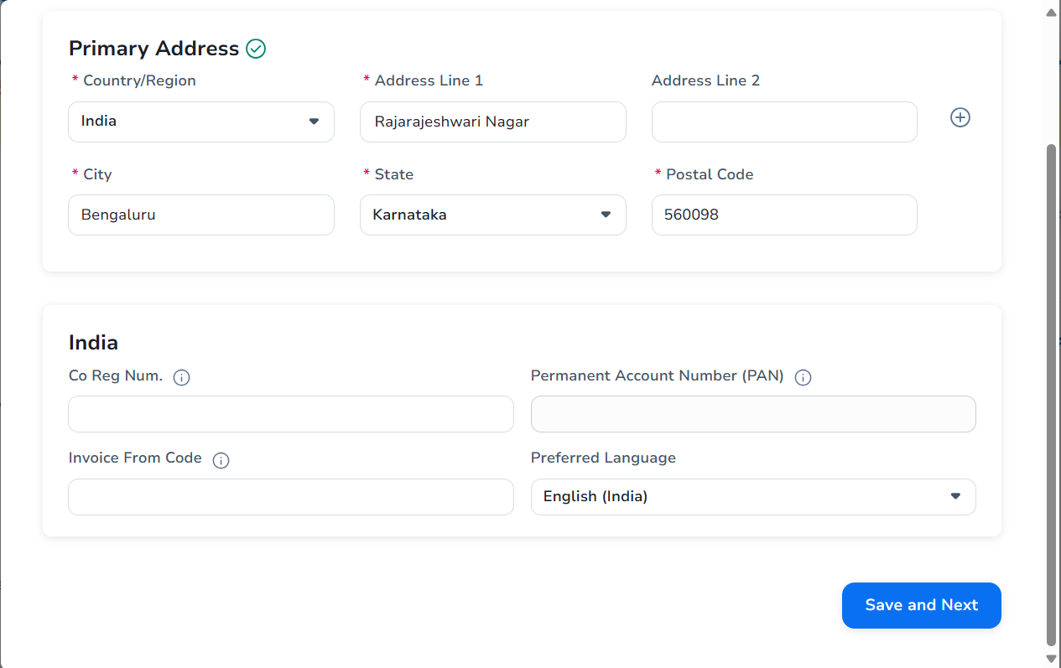
Please fill your company primary address details
Red Asterisk (*) ones are mandatory, so you must fill that information
Fill your company registration Number
Fill you PAN number (Applicable for INDIA)
Click Save and Next

Slide 6
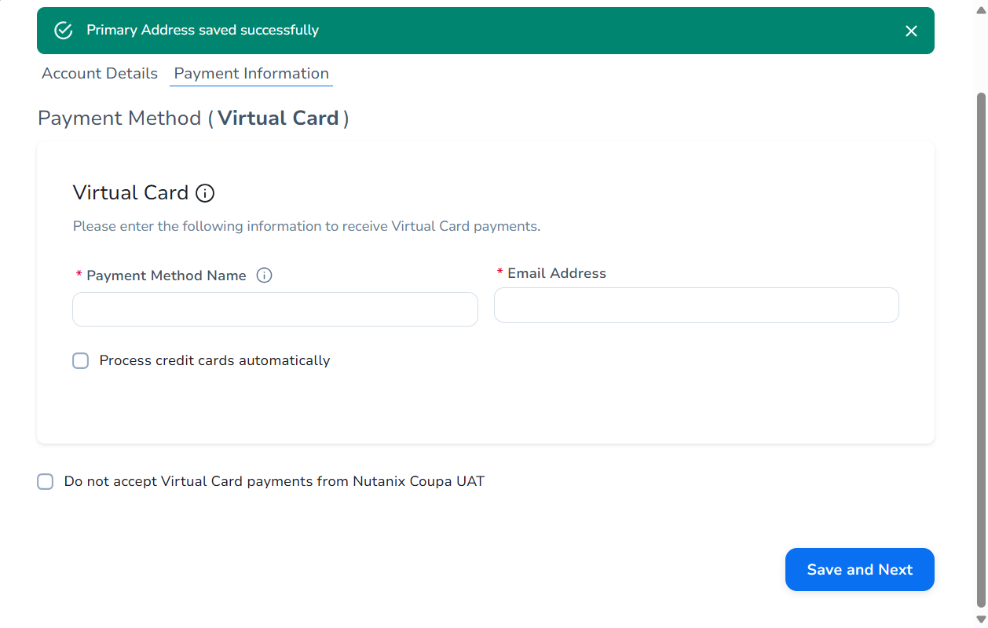
Once your address has been updated, you will be prompted to fill out the banking details. In order to receive payments through bank transfer, this information is necessary.
Please click Save and Next after entering all required bank information.
Payment method 1 (Virtual Card)
You may fill these details in case you want to receive payment Via virtual card
Usually, Suppliers do not accept Virtual Card Payments
Check this box if you do not want receive payments through this Virtual Card
Click Save & Next

Slide 7
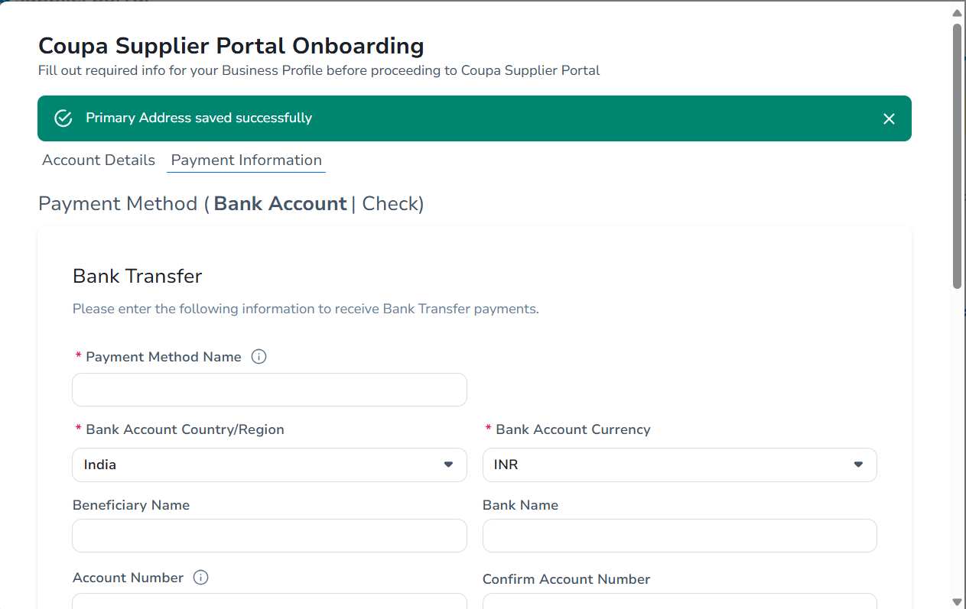
Payment Method 2 (Bank Transfer)
Please fill bank details to receive payment through “BANK TRANSFER”
Payment Method name is “Bank Transfer”
Select Bank account Country
Select Bank account Currency
Fill Beneficiary Name
Fill Bank Name

Slide 8
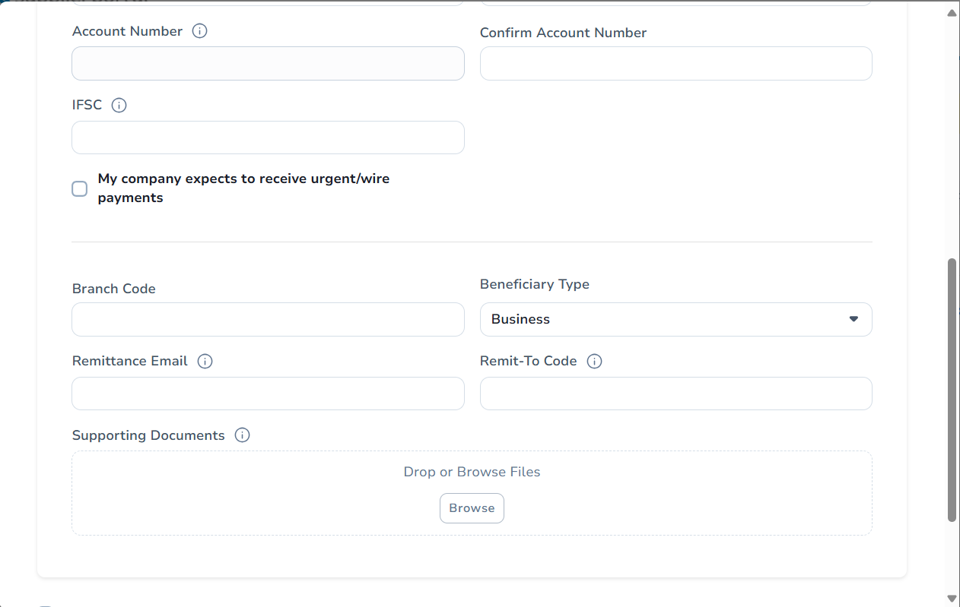
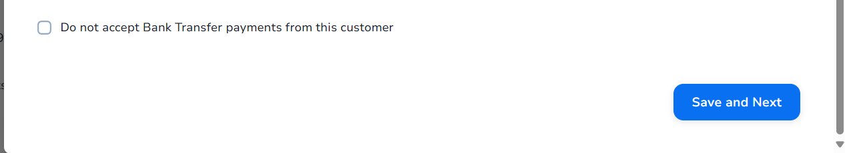
Type the bank account number again
Fill Bank Account Number
Fill IFSC Code (Mandatory for India based Vendors)
In case your company expects urgent/wire payments you may fill below information, if not you can ignore it (usually it will be ignored)
Attach Bank form / Cancelled cheque (Mandatory)
Click Save & Next

Slide 9
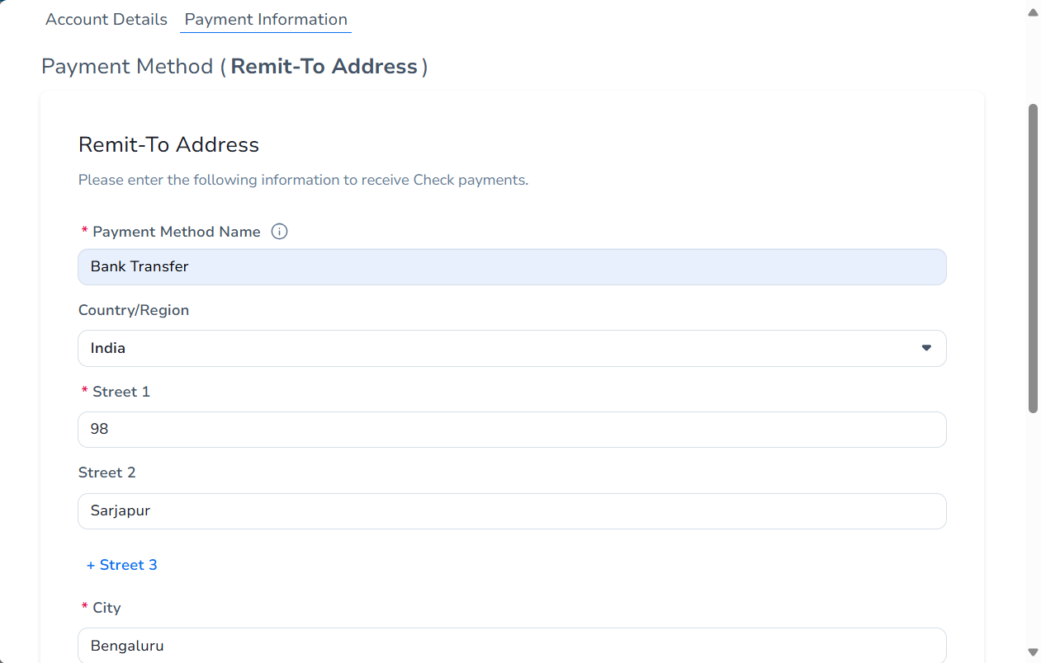
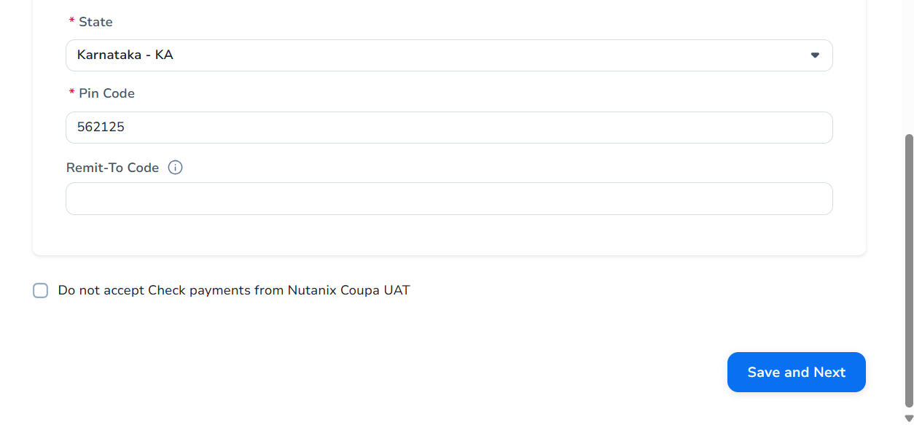
Add Remit-To Address (Mandatory)
Please fill the remit-to address details (this is a mandatory step)
Click Save & next

Slide 10
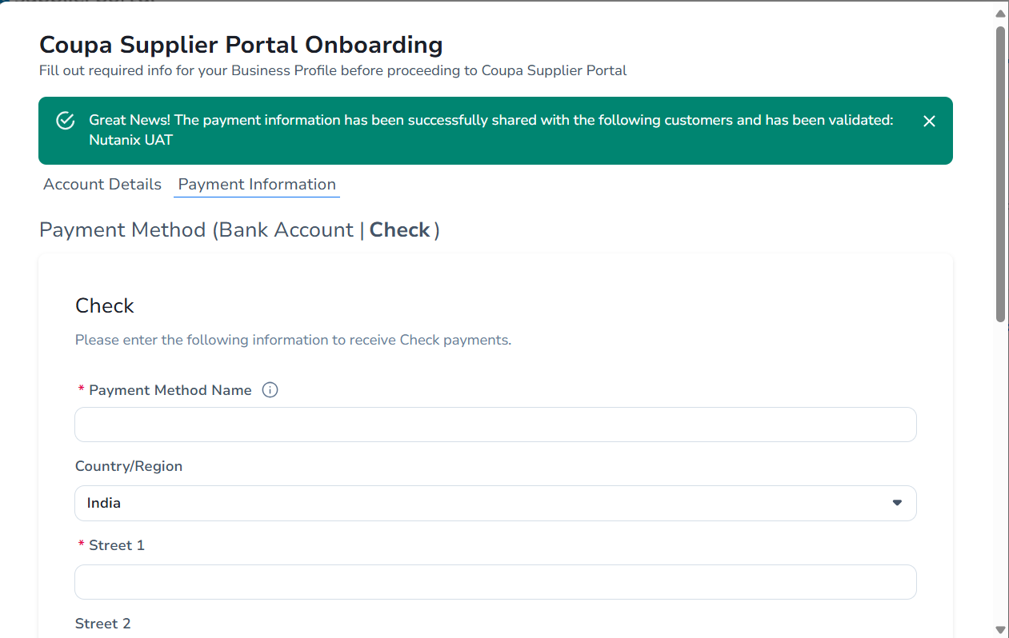
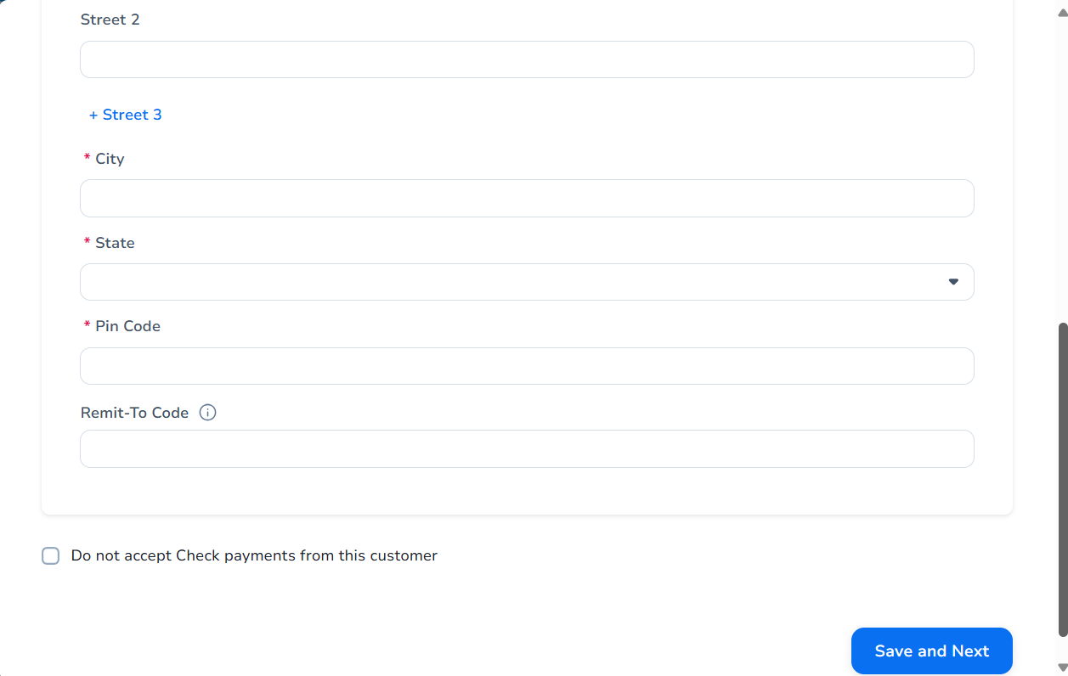
After completing the above information, you will be directed to the page below, where you can indicate if you would want payment by cheque. Simply select "do not accept cheque payment" and then "Save and Next" if you do not wish to accept cheque payments.
Please fill out this form if you would like to be paid only by cheque; otherwise, you can disregard it.
Please tick this check box and click on “Save and Next”

Slide 11
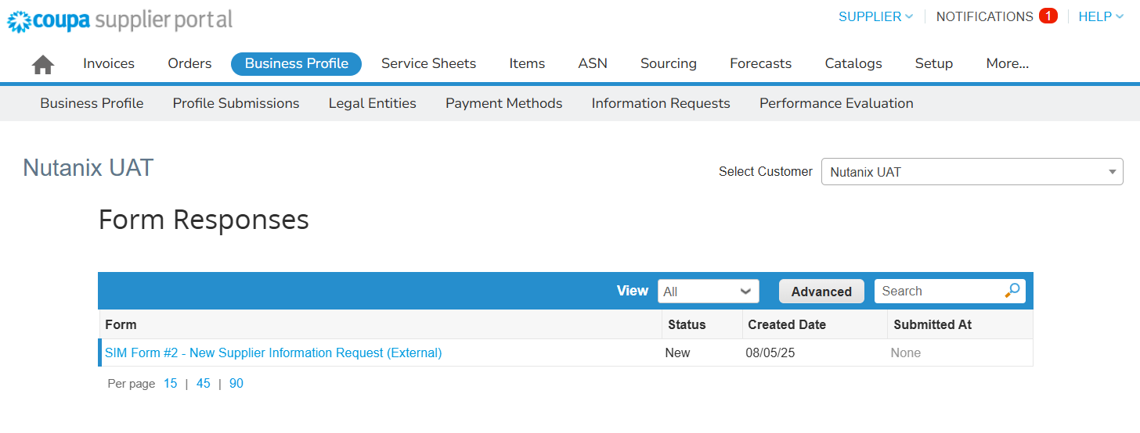
After Bank information updated, it will take you to External vendor form (Form#2) available under Business profile & Information Request. Please click on Form#2
Form#2
Make sure the customer is Nutanix

Slide 12
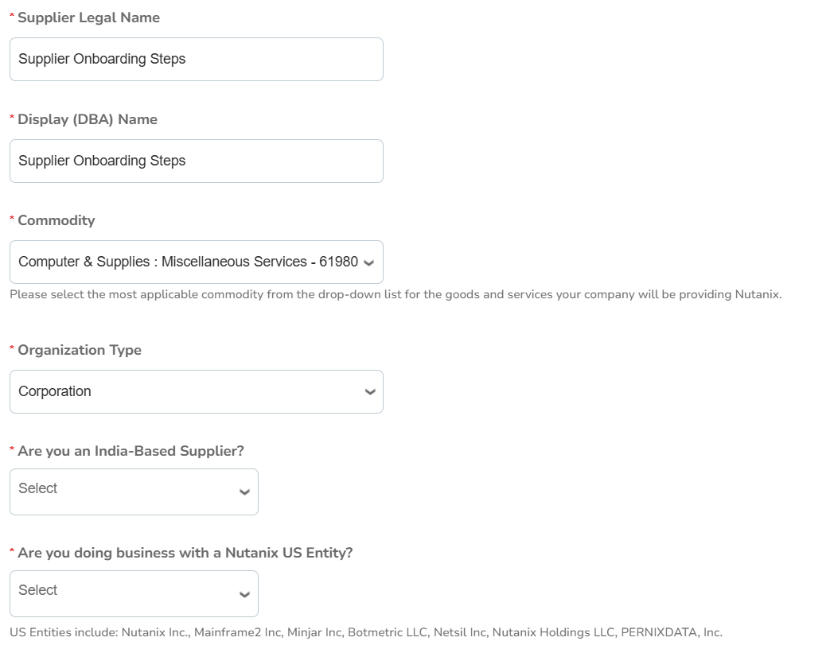
Fill you company’s Legal Name
If your business has a distinct DBA (display name), please fill it out; if not, you can continue using the same legal name.
This may populate automatically. If not, you can select the relevant commodity that you supply
Choose your company type from the drop-down menu.
Please select Yes/No
If your firm is working with our Nutanix US entity, you can choose Yes; if not, choose No.

Slide 13
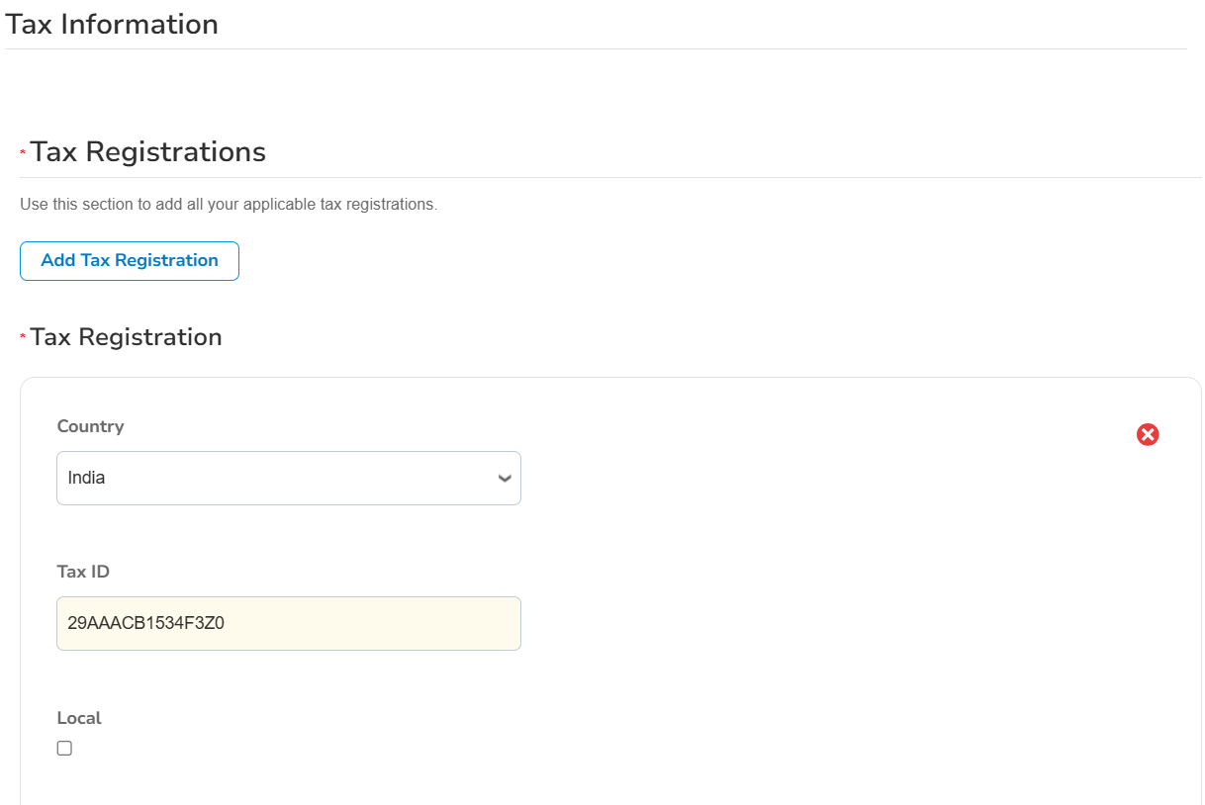
Please include the tax registration information for your business.
Fill your tax registration Country
Please fill your TAX / GST ID
This may populate automatically

Slide 14
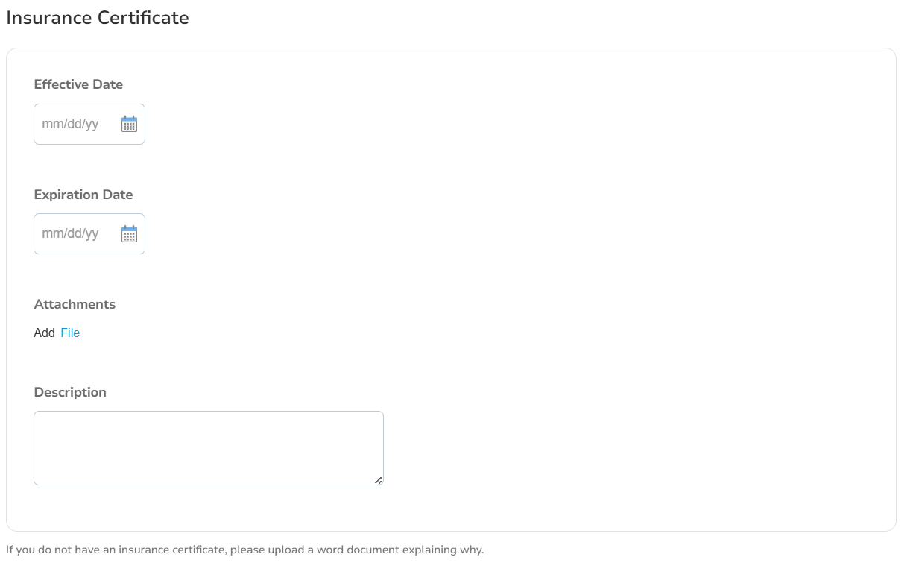
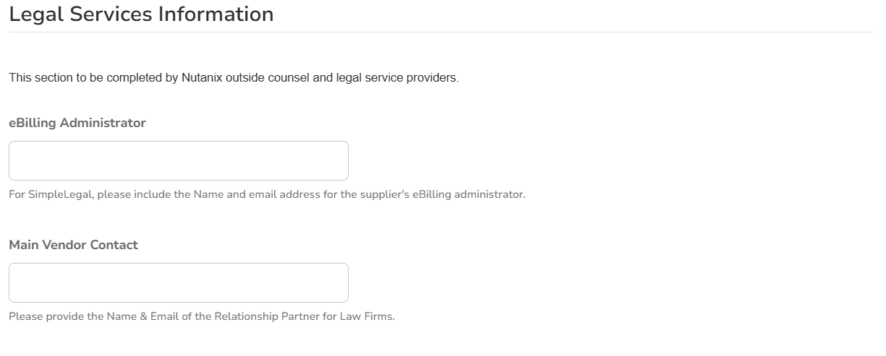
Please provide the insurance information for your business. You can disregard it if you don't have these insurance data.
Please enter the legal services information for your business. You can disregard it if you don't have this information.

Slide 15
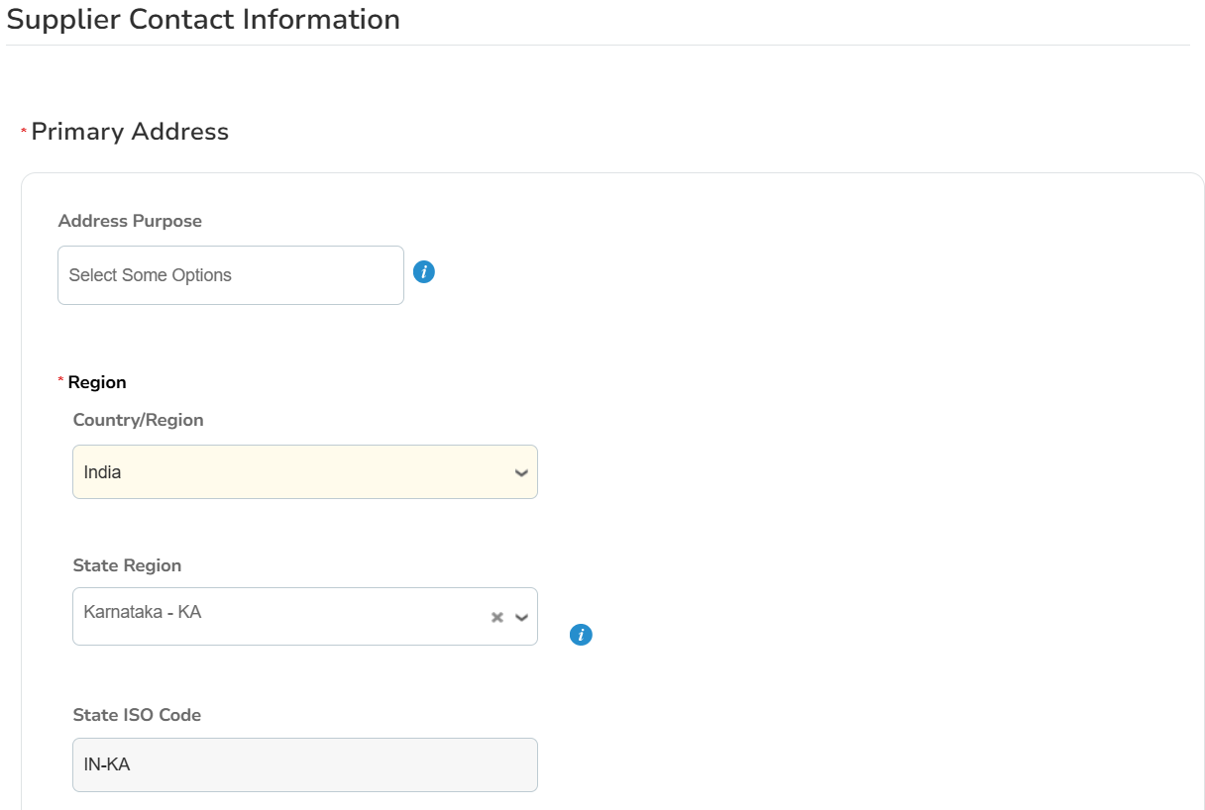
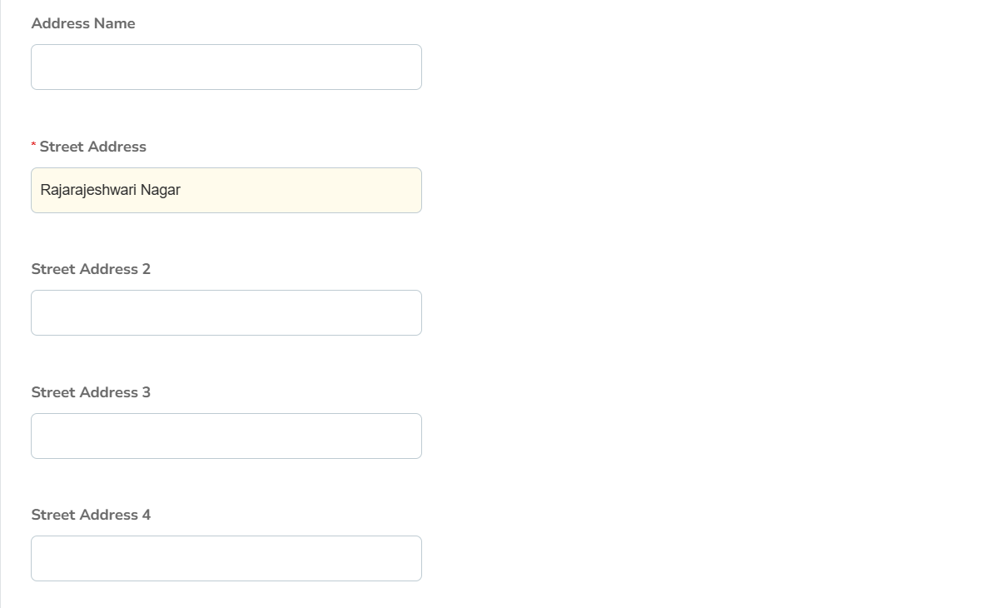
Please enter the primary address details for your business.
Choose the relevant options available (HQ, Branch etc)
Select Country from the drop-down menu
Select State from the drop-down menu
Verify the state code, which can appear immediately following state selection.
You may add your address name (Not mandatory)
Add Street Address
You may add Address 2, 3, 4 if it is available, else ignore it.

Slide 16
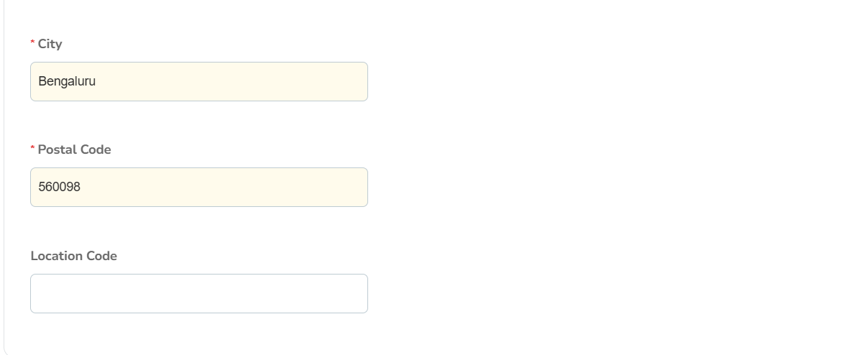
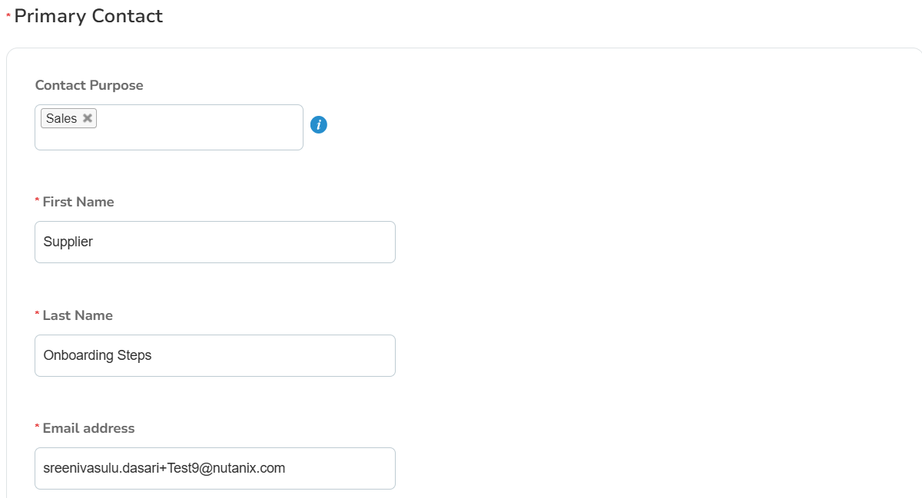
Please fill City name
Fill Postal code
Please enter the location code. If it isn't available, you can disregard it.
Please choose the department which is the primary point of contact to Nutanix.
Enter the first name of the primary contact.
Enter the last name of the primary contact.
Enter the primary contact Email ID

Slide 17
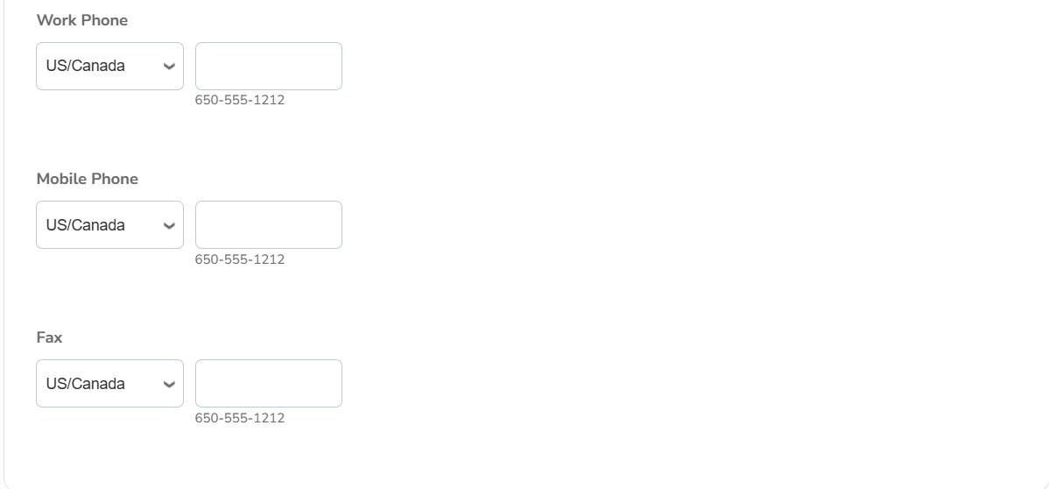
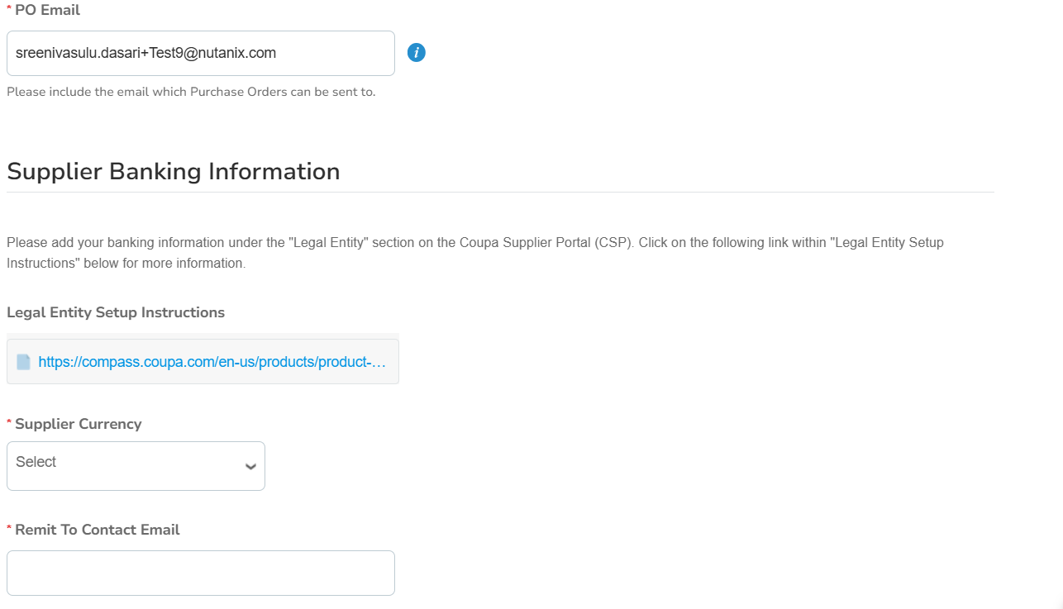
Enter the relevant phone number after selecting the country (only numerics are permitted; do not add +).
Enter the PO email address (this is the email address where Nutanix sends you the authorised PO copy).
Select Currency
Provide email ID that receives remittance notification

Slide 18
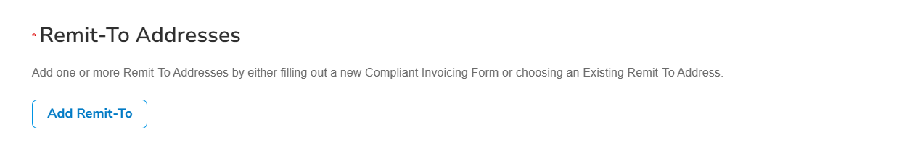
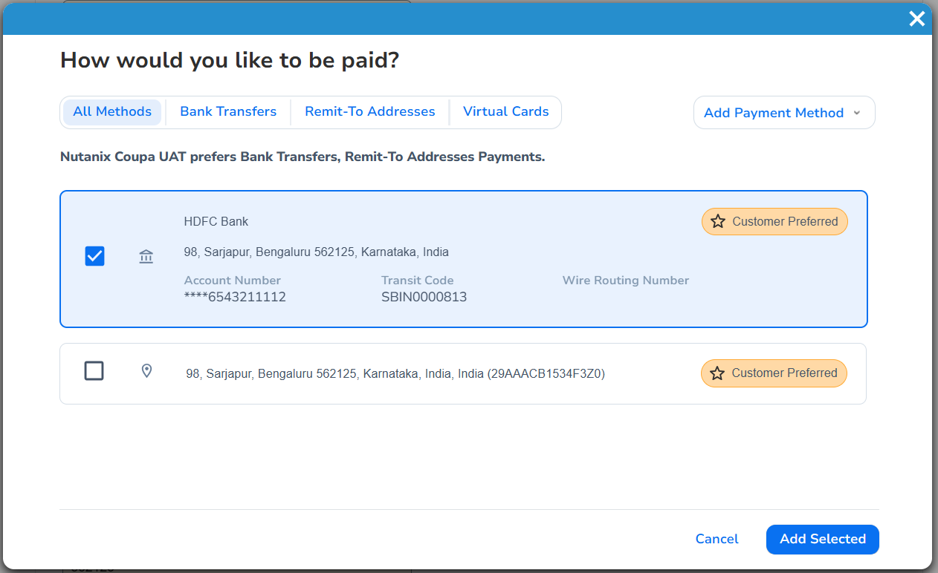
Please click on add remit to so that it will take you to the page where you already filled these details earlier
Add Remit-to is a mandatory step
All the payment methods (Bank transfer, Cheque, Virtual Card etc.) you added will reflect here. Please choose your preferred one
After selecting the payment method, you may click on Add selected

Slide 19
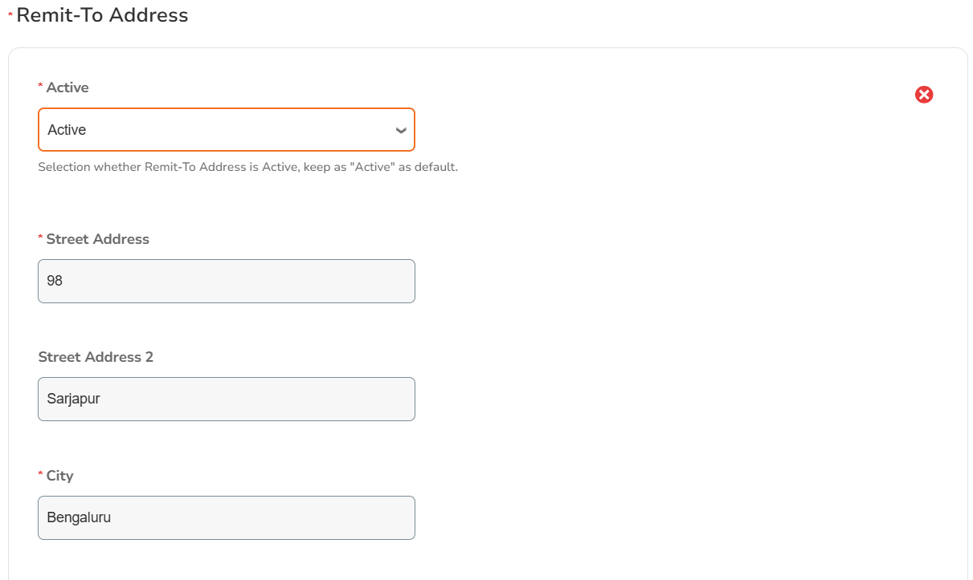
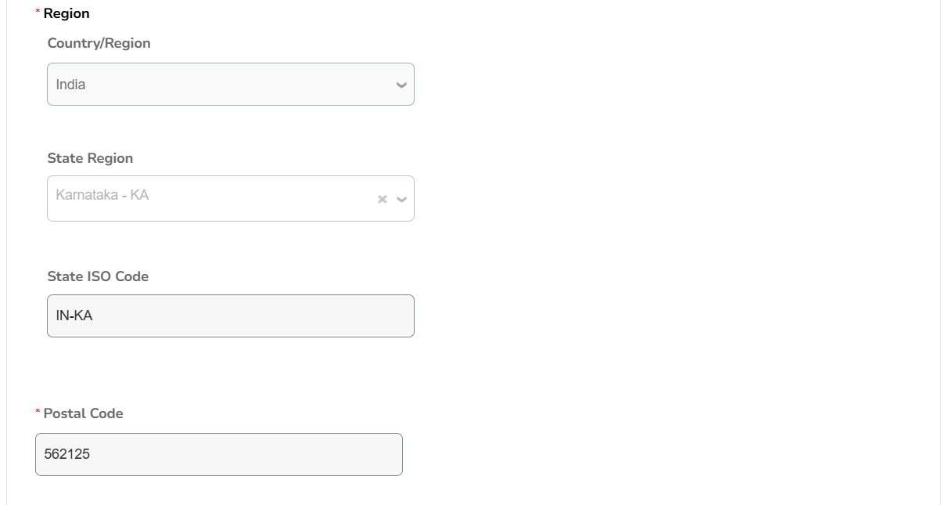
After the Remit to address selected, below screen will reflect.
Address information may populate which was filled by you earlier, if not please fill it accordingly

Slide 20
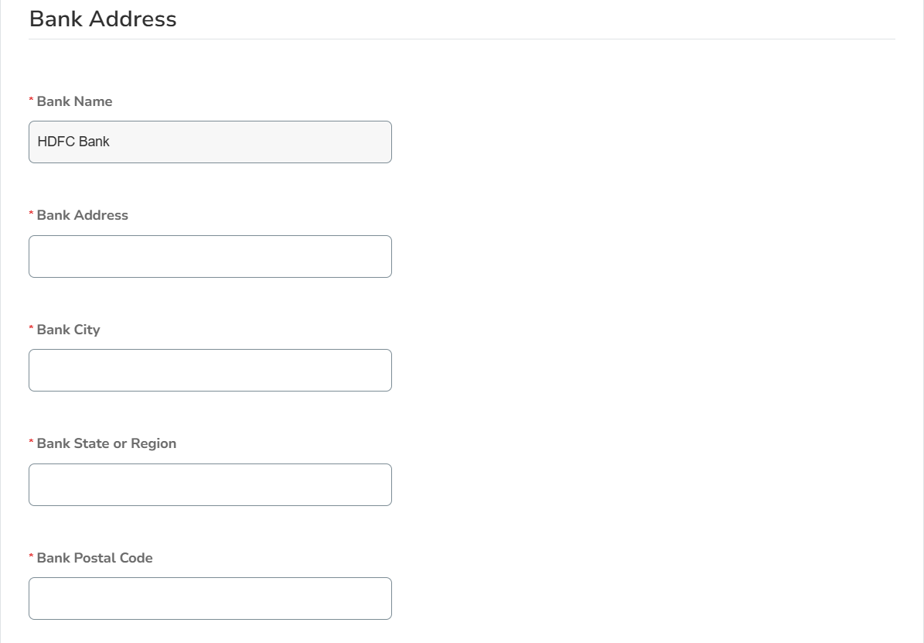
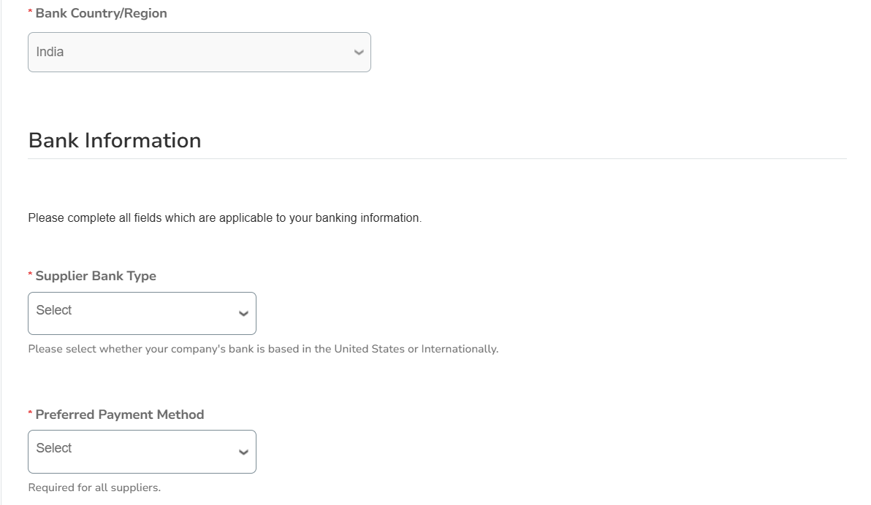
Now, you must fill your Bank address details below
Please fill all the bank details (asterisk ones are mandatory)
Select “International Bank”. In case Bank is based in US, you may select United Stated
Select EFT / ACH from the dropdown list

Slide 21
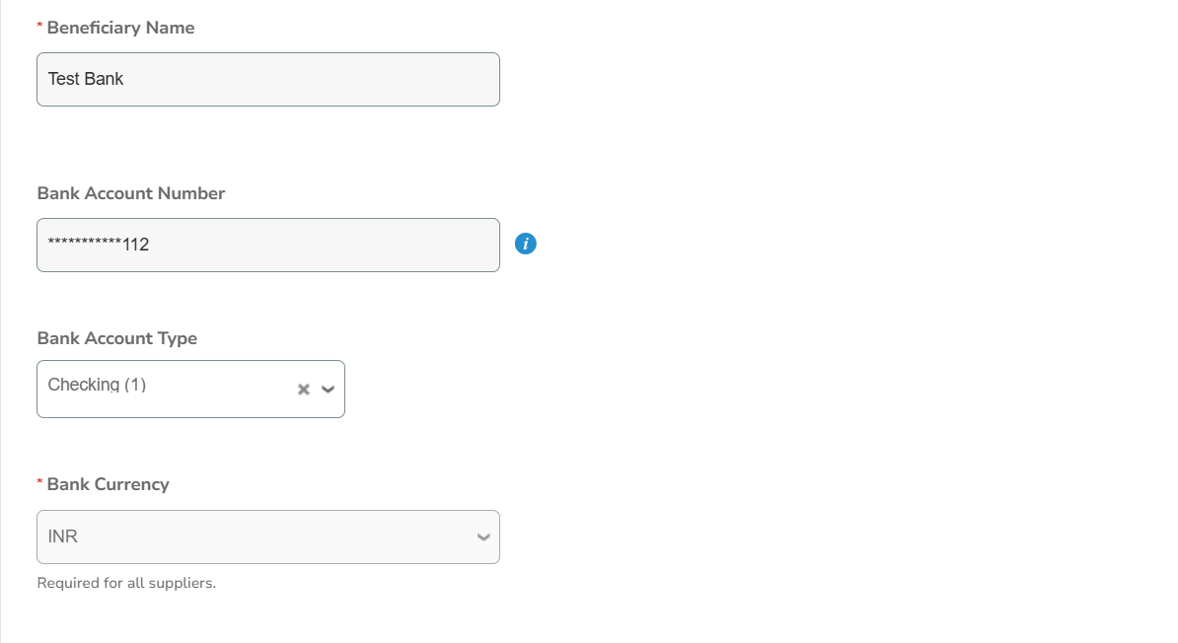
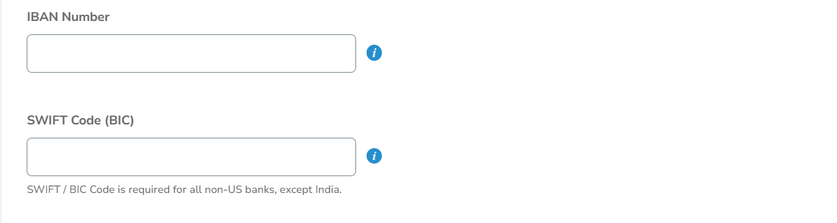
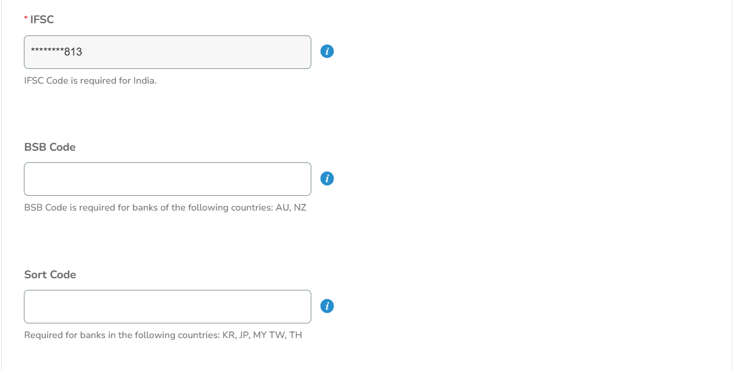
Since these 2 options were already filled by you at the beginning, it may reflect automatically, if not you may fill it.
Select ‘Checking’ from the drop down list
Select the Currency
Fill IBAN number (if available)
Please fill swift Code
This will auto populate since it was already filled by you. If not, you may provide IFSC code
These 2 options are applicable for specific countries. Check the description under these options and fill it accordingly

Slide 22
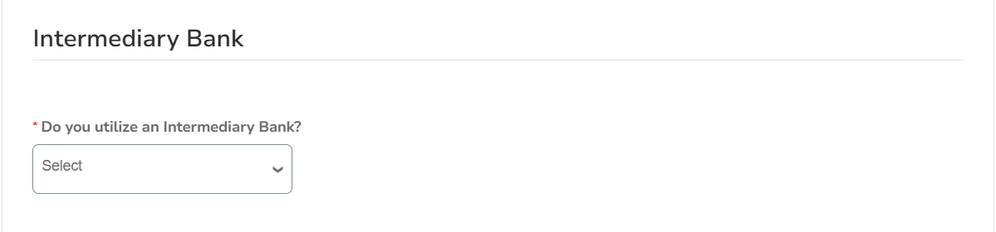
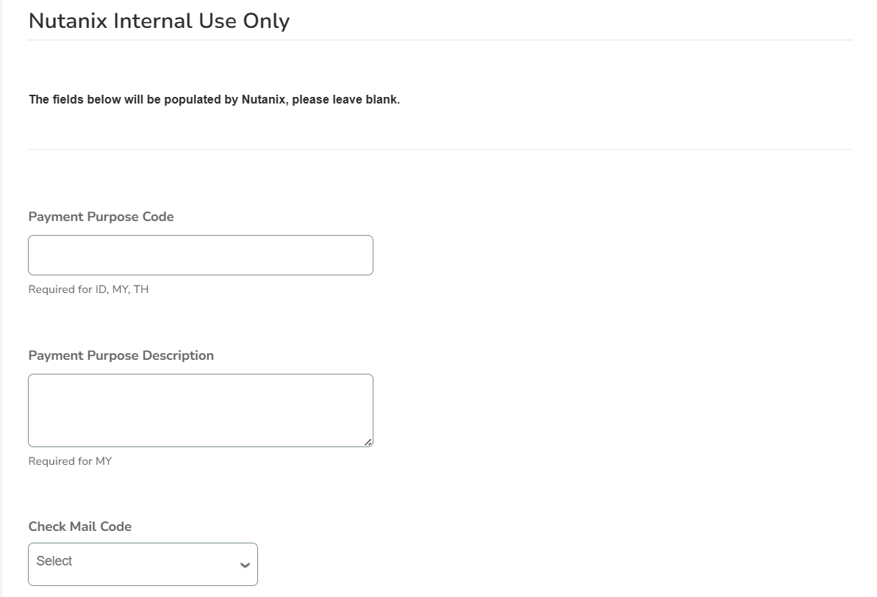
Select ‘NO’
You may skip it as these are for Nutanix internal use

Slide 23
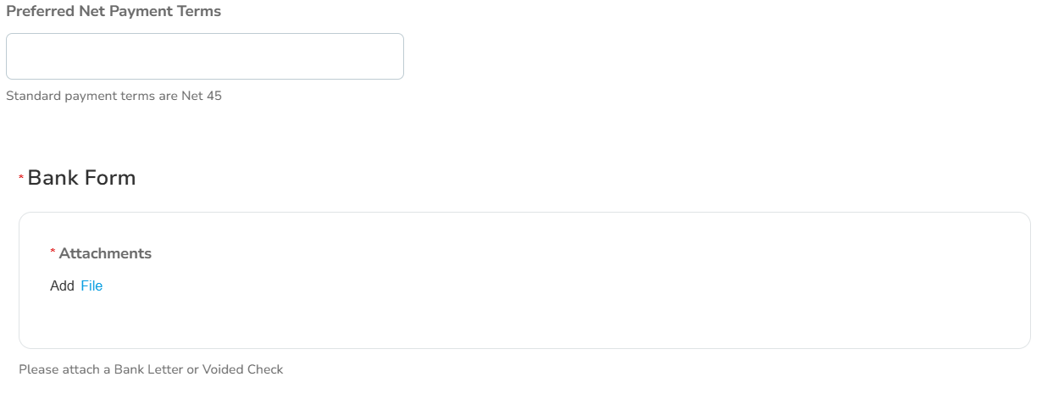
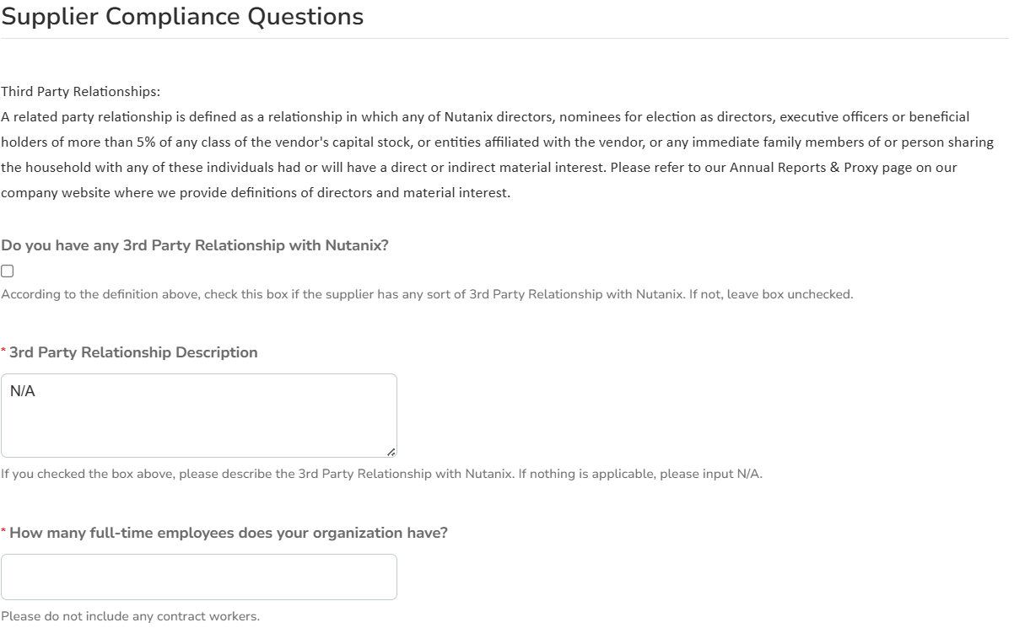
Select Payment term (standard Net 45)
Attach cancelled cheque or Bank form (Mandatory)
Your company’s total employees

Slide 24
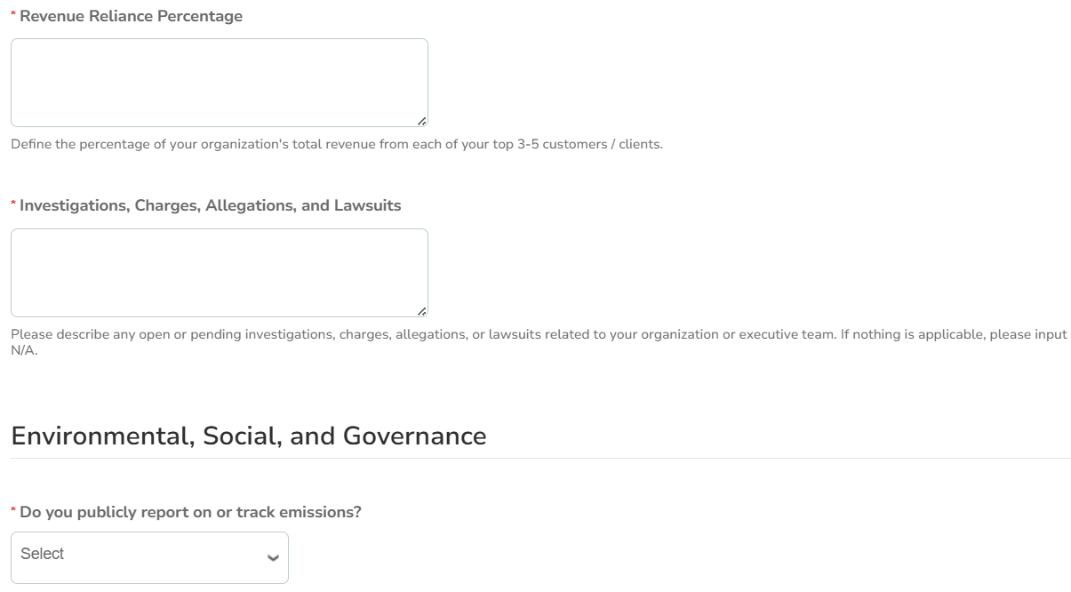
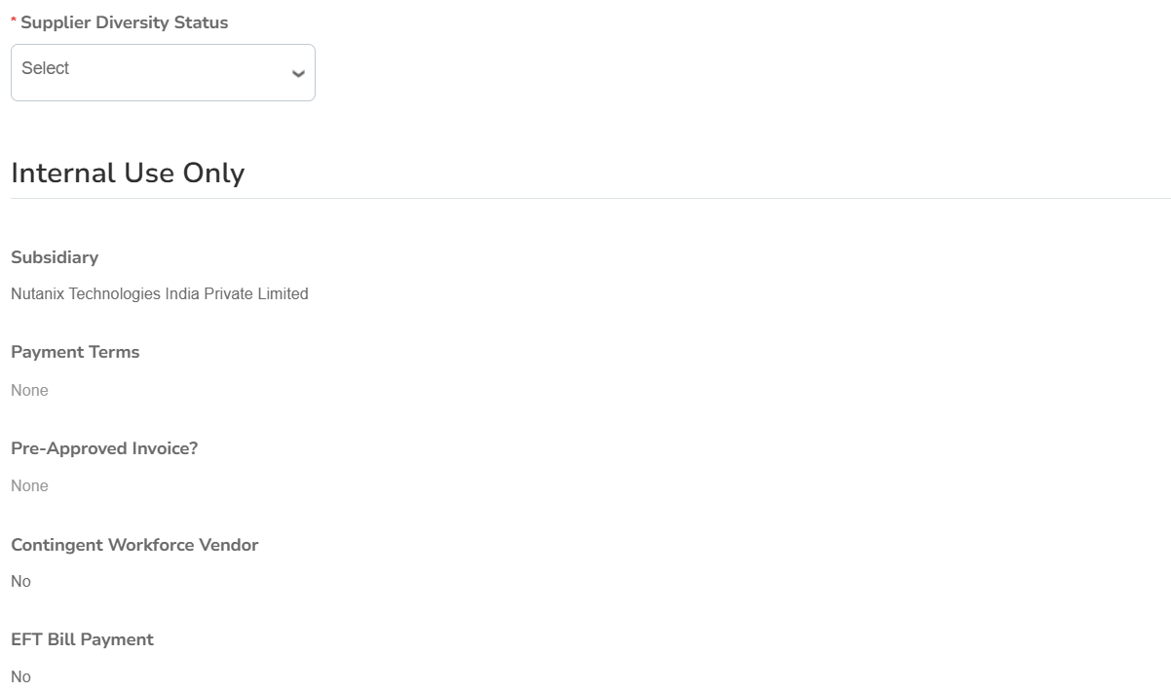
You can provide approximate revenue % your company receives from your top 5 customers
You may fill it not applicable in case of no allegations on your company
Please select the option from drop down list accordingly
These are for Nutanix internal Use only

Slide 25
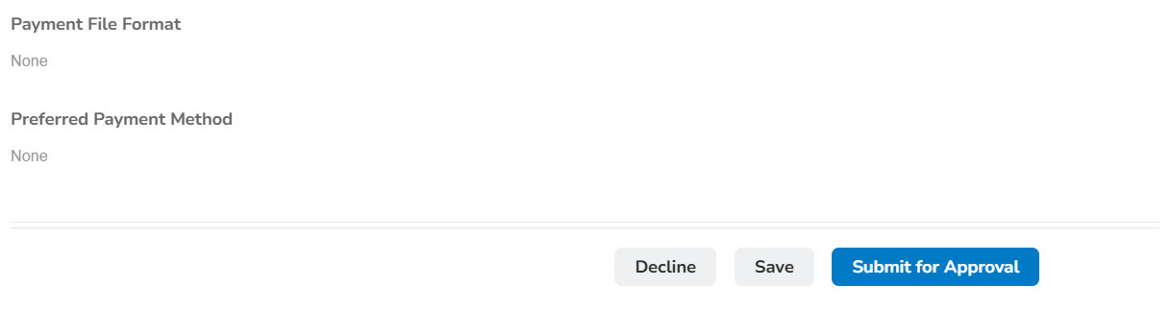
SAVE first to avoid losing any entered information. Then return and click 'Submit for approval'.

