Slide 1
Nutanix Supplier Webinar

Slide 2



Learning Objectives
This guide provides instructions for suppliers on how they can submit their Information to Nutanix via the Coupa Supplier Portal
CenterPoint Energy – Supplier Managers SIM Training Guide

Slide 3
Agenda
Introduction
Logging in to the Coupa Supplier Portal (CSP)
Accepting an email invitation
Profile Setup
Setting up Multi-factor authentication
Managing Additional Users
Creating Legal Entities
Creating Payment Methods
Submitting Invoices
View and Manage POs and Invoices
Creating Invoices from PO
Appendix – Responding to a Supplier Information (SIM) Update Request

Slide 4
Introduction to the Coupa Supplier Portal (CSP)

Slide 5
Introduction to Coupa Supplier Portal (1/2)
The CSP is a no cost tool that allows suppliers to easily do business with Nutanix and other customers. It is the most comprehensive way for suppliers to manage their interactions with Coupa.
Within the portal, suppliers can manage content and settings, such as:
View and acknowledge purchase orders.
Create invoices.
Host and manage catalogs.
Update profile and payment information.
Real-time exchange of transactional notes.

Slide 6
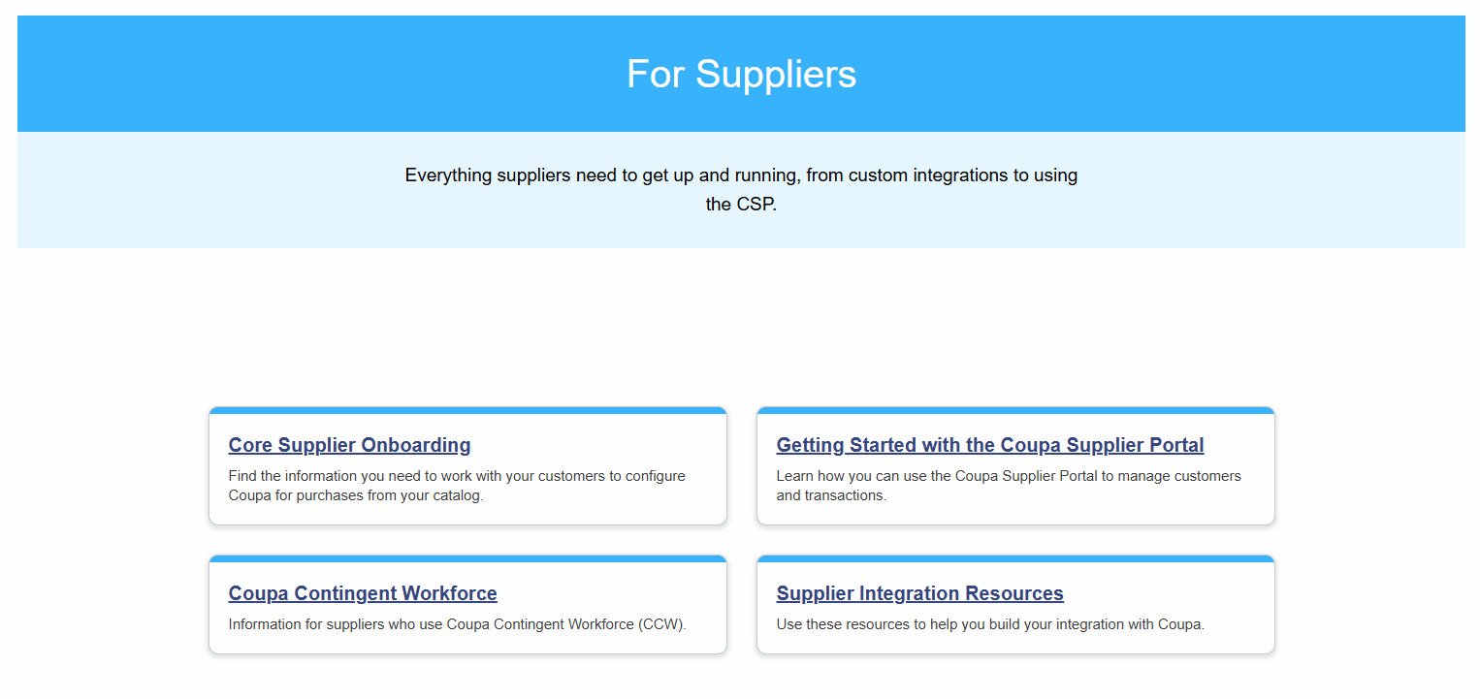
Introduction to Coupa Supplier Portal (2/2)
For more information about the Coupa Supplier Portal please visit:
https://compass.coupa.com/en-us/products/product-documentation/supplier-resources/for-suppliers

Slide 7
Logging in to the CSP

Slide 8
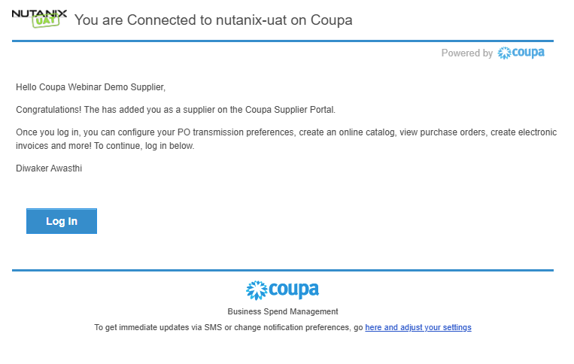
Accepting a Connection Invitation
An invitation email, sample below, will be sent to the Primary Contact.
The Primary Contact is considered the Administrator of the Supplier’s CSP account and does not have to be the primary business contact.
Click Log In to continue.
Note: Check your Spam or Junk folders if you have not received an expected invitation.

Slide 9
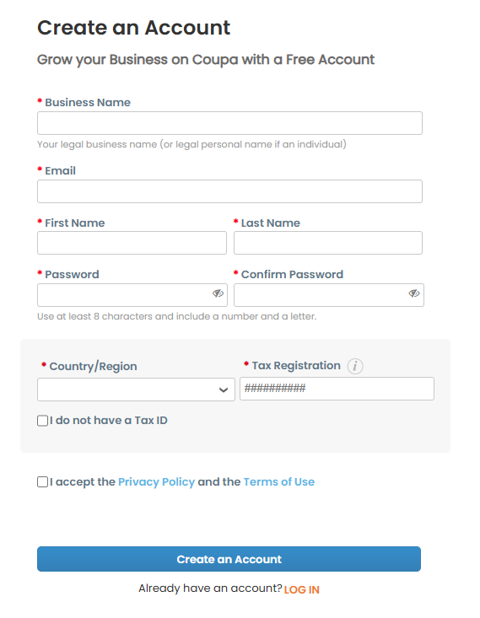
Creating an Account
Suppliers without an existing CSP account will need to complete the required fields to create an account.
Required fields are marked with a red asterisk (*).
A one-time verification code will be sent to the primary contact’s email. Future codes will be provided via multi-factor authentication when needed.
Suppliers with an existing CSP account will be able to Log In instead.
The login email must match the address where the invitation was received.

Slide 10
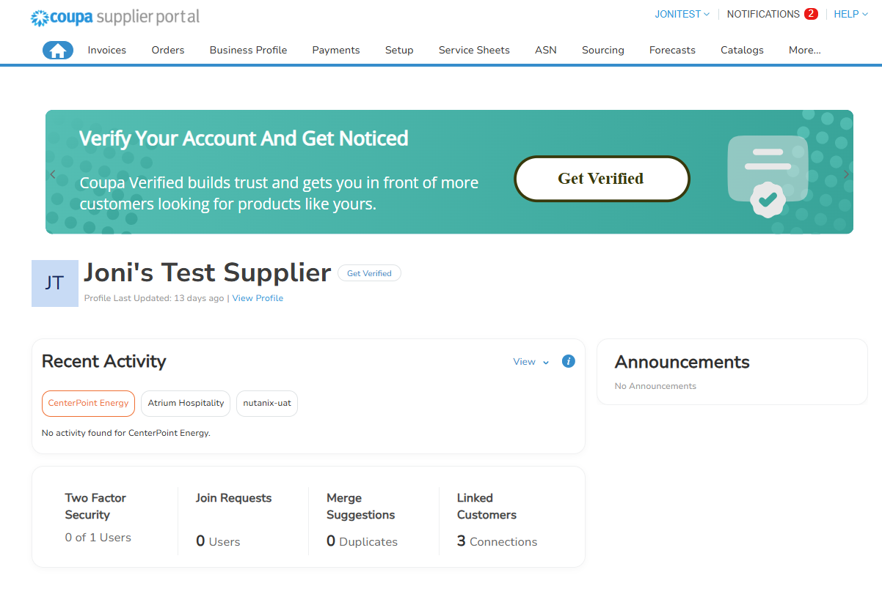
Home Page and Multi-Factor Authentication
Suppliers will be prompted to setup Multi-Factor Authentication (MFA or 2FA) after the first log-in. After either setting up MFA, the home page will be displayed.
Multi-factor authentication will be covered in the next section.
Note: Coupa Verification is a paid service and is not required to do business with Nutanix.
Coupa Supplier Webinar
Customer 1
Customer 2

Slide 11
Profile Setup

Slide 12
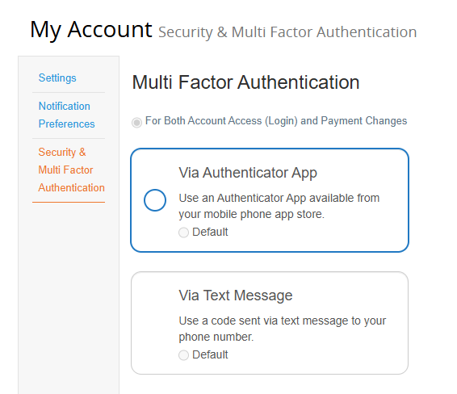
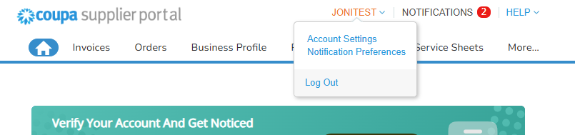
Setting up Multi-Factor Authentication
Multi-Factor Authentication (MFA) is required to manage legal entities and other financial details. Suppliers may choose to use an authentication app or to use SMS – however, the authentication app method is more secure and is the recommended method.
Suppliers will be prompted to set up MFA as part of their first log-in.
Suppliers with existing CSP accounts will need to navigate to the Account Settings page instead.
Hover over the Name Menu
Click Account Settings
Click Security & Multi Factor Authentication

Slide 13
Setting up Multi-Factor Authentication
Via Authenticator App
Most secure
Free authenticator apps through Microsoft, Google, etc.
Via SMS
Will send a code through text
Often slower to deliver codes than an authenticator app

Slide 14
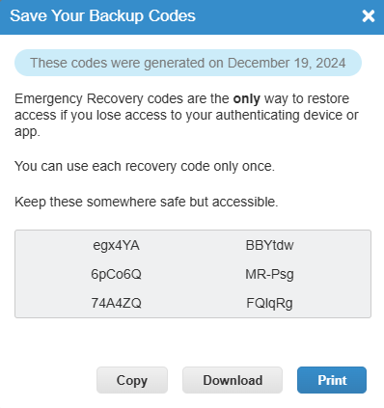
Setting up MFA – Recovery Codes
Recovery codes are one-time use and allow the user to skip MFA. These are backup codes only, not to be used as the primary verification method.
Download or copy codes.
These codes are a sample only.

Slide 15
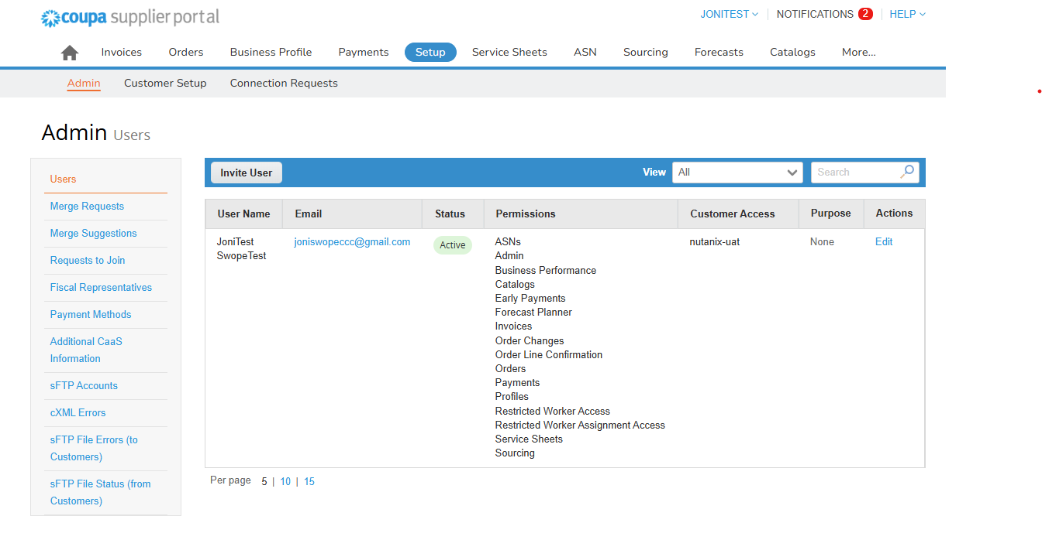
Managing Additional Users
Suppliers are able to add as many users as needed to support transactions with Nutanix or other customers using Coupa. The Admin will need to create new accounts and assign permissions to new users.
The Admin page provides quick links to user management, legal entity setup, and several other management tools.
Invite New Users
Click Setup.
Click Users.
Click Invite User.
Complete required information.

Slide 16
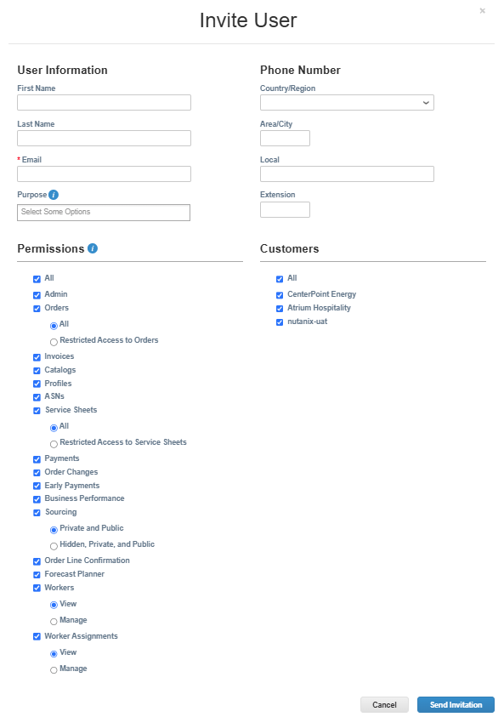
Managing Additional Users
First Name, Last Name, and email are required.
Manage Permissions
Only give relevant permissions.
If the supplier has multiple customers using Coupa, the Admin is able to grant or revoke access to specific customers by checking the box next to the customer’s name.
Finish by clicking Send Invitation.
The invited user will be able to set up their own MFA and manage their own notifications.
Nutanix

Slide 17
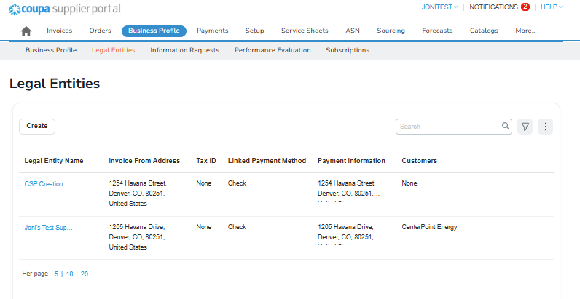
Creating Legal Entities
Legal Entities are used to manage payment information and may have one or more Remit-To address and/or Ship From address attached. Legal Entity details will automatically populate on invoices once created.
Legal Entities are best managed through the Business Profile page.
Use the Quick Links to access the Legal Entities table.
Suppliers may be prompted to enter the MFA code from either the app or SMS.
Click Create.
Nutanix

Slide 18
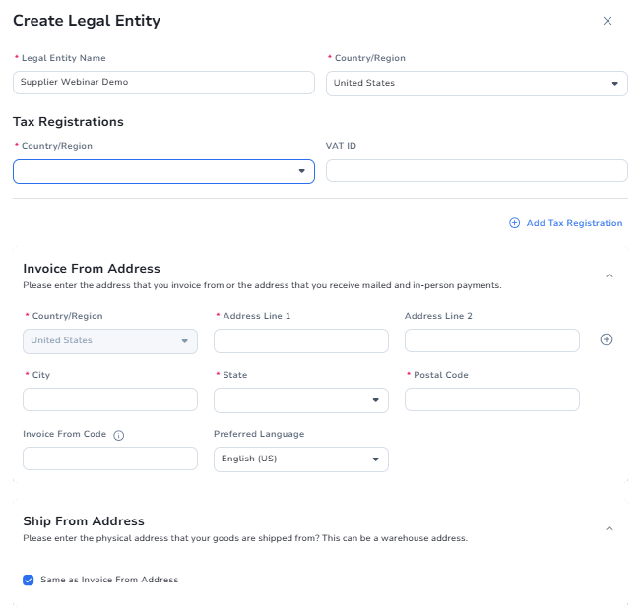

Creating Legal Entities
Follow the prompts to complete legal entity setup.
Legal Entity name must be the full legal business name, not the DBA (doing business as) name.
Select Country/Region where the business is registered.
Complete Tax Registrations. VAT ID will display for non-US entities instead of Tax ID.
Complete Invoice From Address.
Click Save.

Slide 19
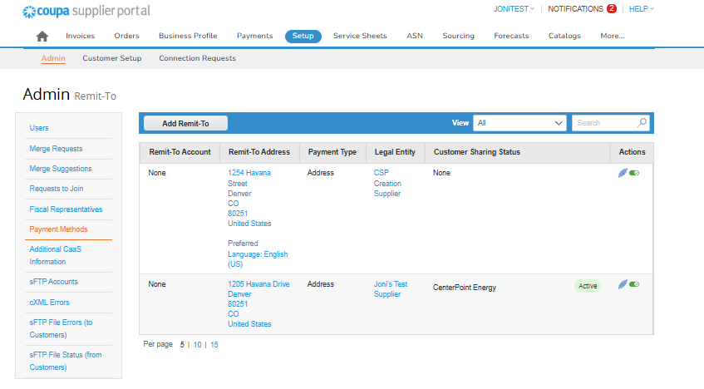
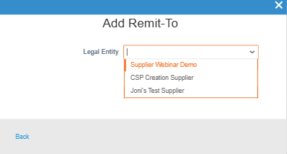
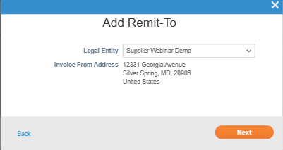
Creating Payment Methods
Payment Methods are used to manage Remit-To information.
Click Add Remit-To
Select Legal Entity. The Invoice From Address will populate.
Click Next.
Nutanix

Slide 20
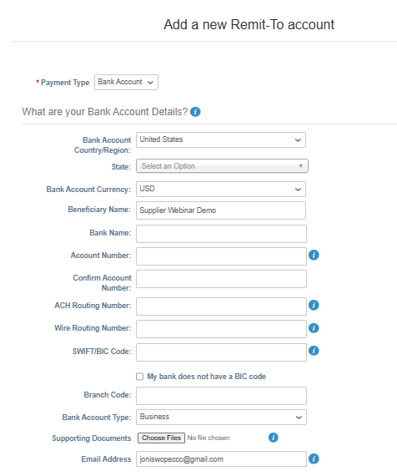
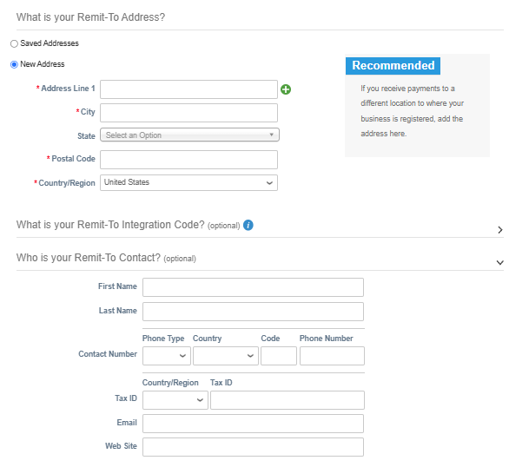
Creating Payment Methods
Complete required information. Click Save & Continue. Note: BIC Code is a Coupa-required field.

Slide 21
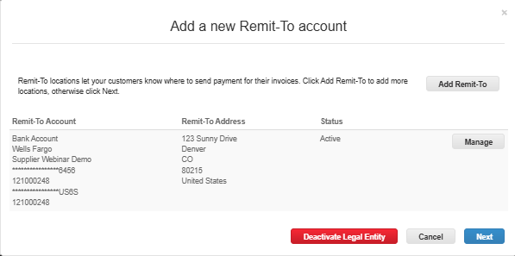
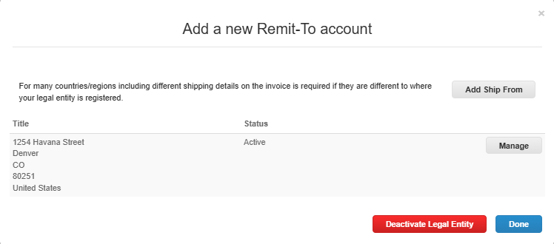
Creating Payment Methods
Review the information and click Next. Confirm the Ship From address is correct and then click Done.

Slide 22
Submitting Invoices

Slide 23
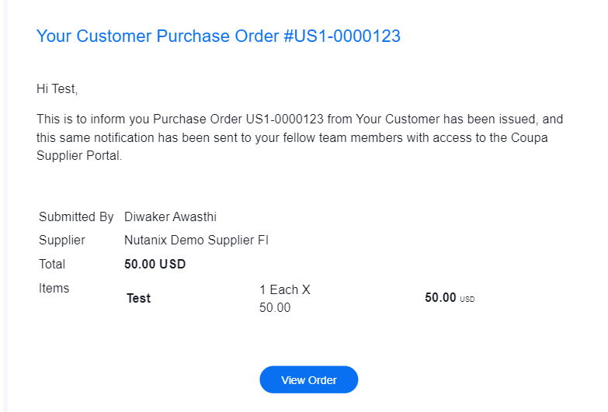
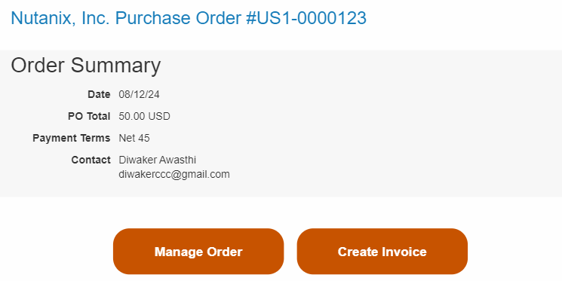
View and Manage POs and Invoices
Suppliers will receive purchase order emails from Coupa. They can directly manage the purchase orders or create invoices against the purchase orders by logging into the Coupa Supplier Portal (CSP). Below are example PO notification emails.

Slide 24
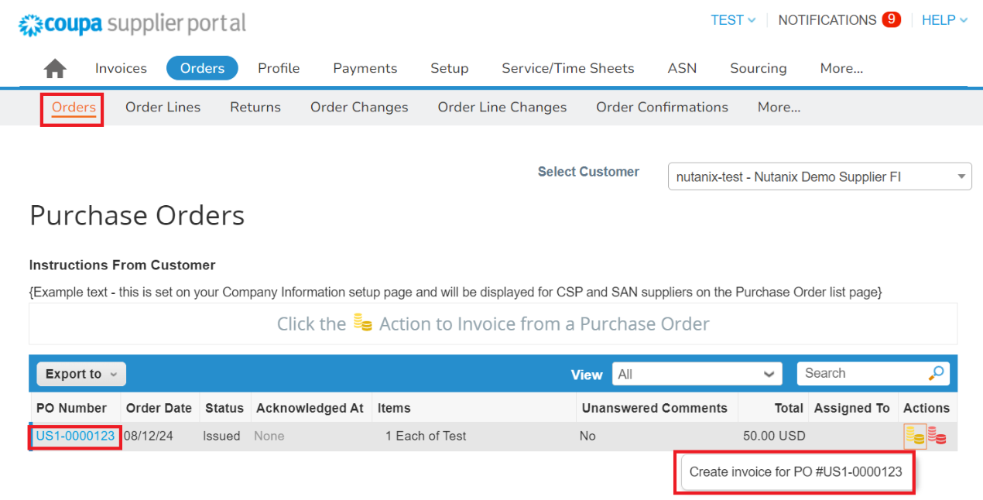
Create Invoice from PO
POs may also be found in the Orders tab directly, without accessing a notification email.
Blue PO numbers are clickable and open the PO details.
The gold coins icon will open a draft invoice.
The red coins icon will open a draft credit note.
The table is searchable and also exportable to CSV or Excel.

Slide 25
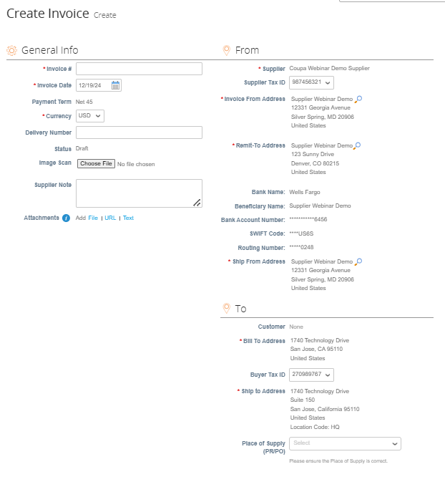
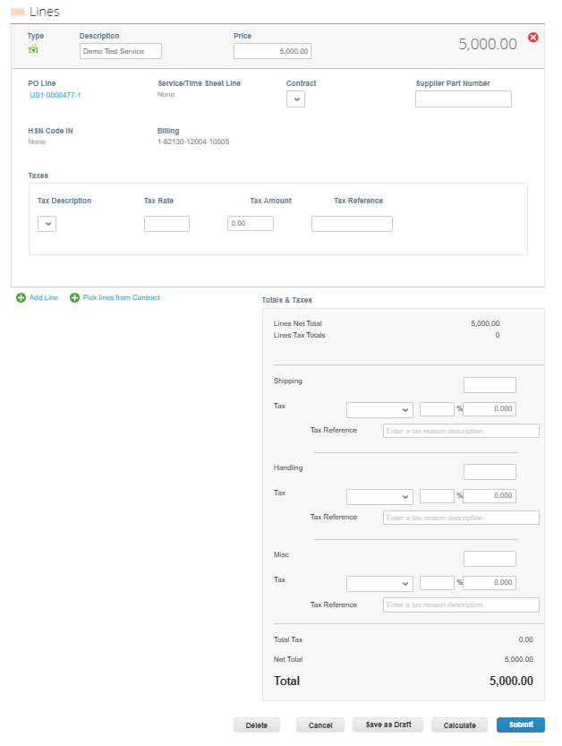
Create Invoice from PO
Complete all header and line-level details before submitting for approval. Remit-to details will automatically populate. Be sure to include summary tax information.

Slide 26
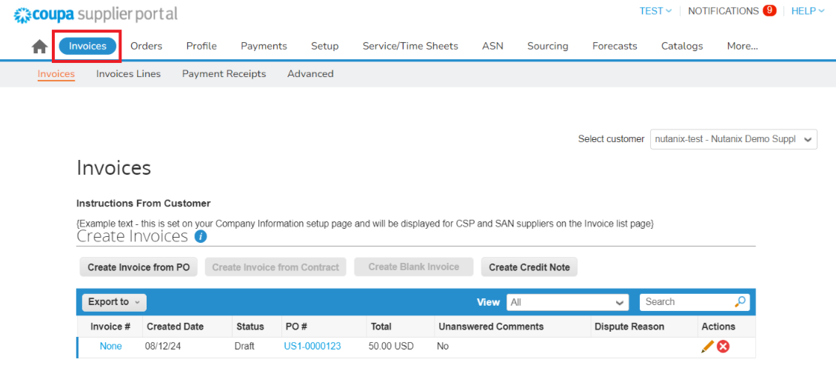
View and Manage Invoices
To view existing invoices, click on the Invoices tab on the main menu.
Blue invoice numbers are clickable and open the invoice details.
Any actions available will be listed in the Actions column, fore example Edit (pencil) or Delete (red X).
The table is searchable and also exportable to CSV or Excel.

Slide 27
Invoice Statuses
Status | Description
Abandoned | The disputed invoice has been abandoned. Your customer can choose to notify you of this invoice status change and provide instructions. You can set notification preferences for abandoned invoices.
Approved | The invoice has been accepted for payment by your customer.
Disputed | The invoice has been disputed.
Draft | The invoice has been created, but it has not been submitted to your customer yet.
Invalid | Specific for compliant e-invoices for clearance countries, for example, Mexico. It indicates that a CFDI (Mexican legal invoice form) that you sent failed validation. Invoices with this status are visible only to you, not to your customer.
Pending Approval | The invoice is currently under review by your customer.
Processing | The invoice is being processed by the AP department and should be paid soon.
Voided | Something is wrong with the invoice. Contact your customer to get the invoice back on track.

Slide 28
Create Invoice without PO
If you need to create a non-PO invoice, you will not be able to submit this through the Coupa Supplier Portal. Non-PO backed invoices will need to be emailed to the respective Accounts Payable inbox in line with the current process happening today.
North America: invoices@nutanix.com.
International: intl-invoices@nutanix.com.
India: india-invoices@nutanix.com

Slide 29
Thank You

Slide 30
Appendix – Responding to a Supplier Information (SIM) Update Request

Slide 31
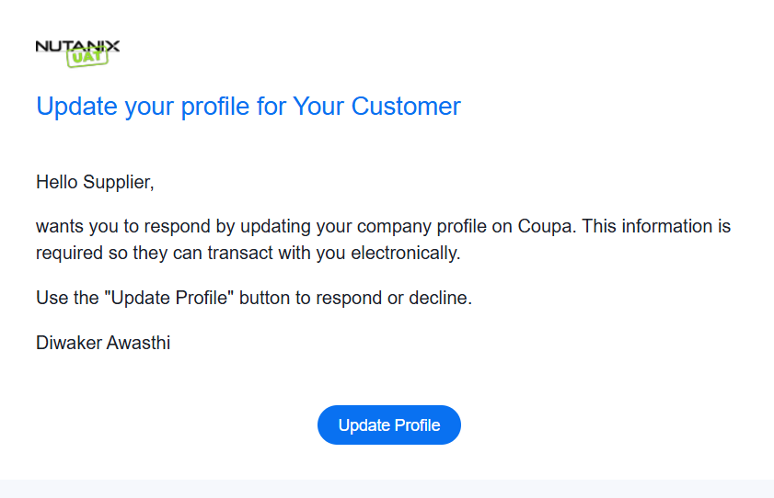
SIM Invitation
Suppliers may receive Supplier Information requests email from Nutanix to register and update the information.

Slide 32
SIM Invitation
Some information will be prefilled from existing information. Form questions may be updated by Nutanix over time, but the key sections are listed below:
Supplier Company Information
Tax Information and Tax Registration
Insurance Certificate
Legal Services Information
Supplier Contact Information
Primary Address
Primary Contact
Supplier Banking Information
Remit-To Addresses
Supplier Compliance Questions
Environmental, Social, and Governance

Slide 33
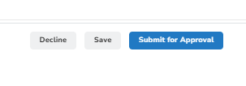
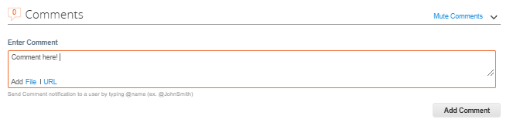
SIM Invitation
Once complete, click Submit for Approval. While a supplier may decline to update information, incorrect information may result in payment delays.
Comments may be sent between Nutanix and the Supplier using the comment section at the bottom of the page.

